Slide 1
Requirement 1: single campaign
REQUIREMENT 1
The warm-up

Slide 2
The Setup, in Short
ONE CAMPAIGN, MANY ROUNDS
ALGORITHMS COMPARED
One campaign bids again and again
Each round: win or lose the auction
A winning bid uses up part of the budget
The budget can run out before the end
UCB1
does not plan the budget
Budgeted UCB
plans spending every round
UCB1-Tuned
explores in a smarter way
Rescaled-Constant UCB
explores in a smarter way
THE ENVIRONMENT, IN NUMBERS
Value = 1.0 · Horizon = 1,000 rounds · Budget = 300 · Competing bid ~ Uniform(0.1, 0.7) · 2 competitors · 11 candidate bids (0.0–1.0)

Slide 3
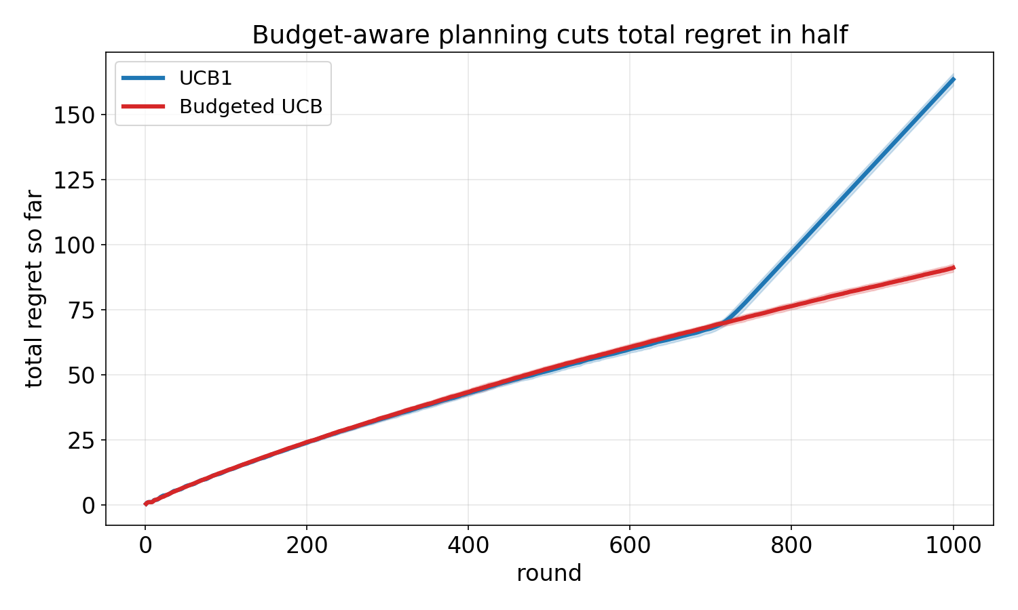
Planning the Budget Cuts Regret in Half
1,000 rounds · budget = 300 · averaged over 30 runs
163 → 91
total regret
UCB1 vs. Budgeted UCB
UCB1 runs out of money around round 700 and stops playing for the rest of the campaign. Budgeted UCB paces its spending and plays every single round.

Slide 4
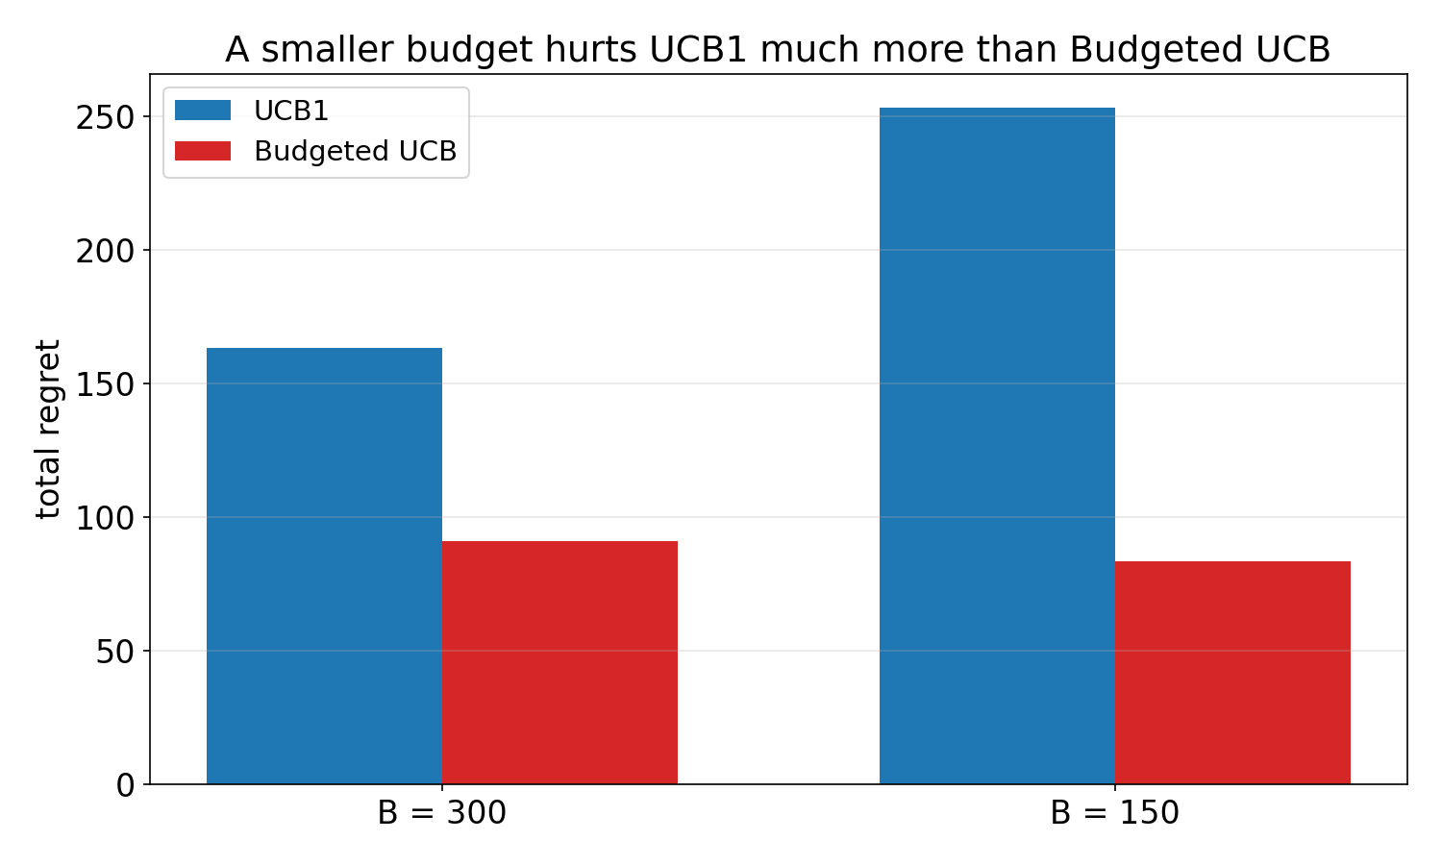
A Smaller Budget Hurts the Blind Algorithm
same test, budget lowered from 300 to 150
+55%
more regret for UCB1
when the budget is cut
Budgeted UCB stays about the same, even with much less money to spend. Planning the budget matters even more when money is limited.

Slide 5
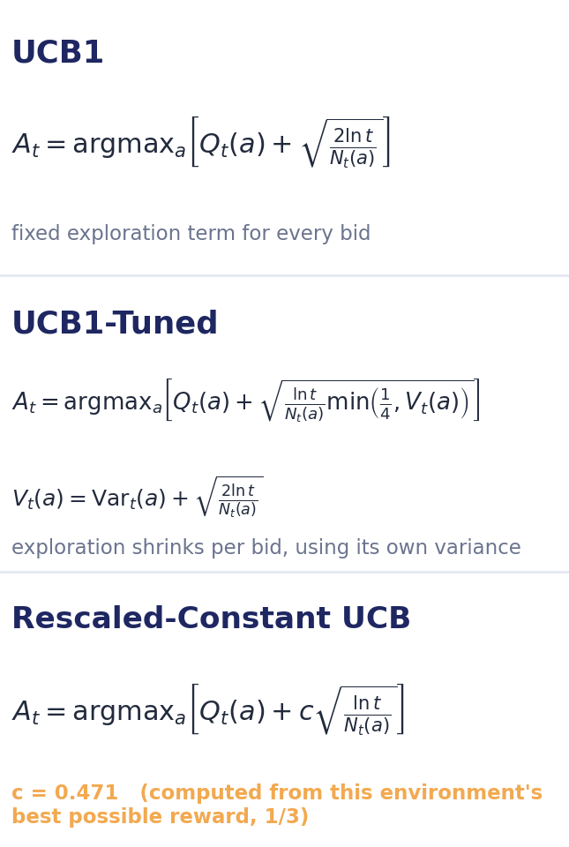
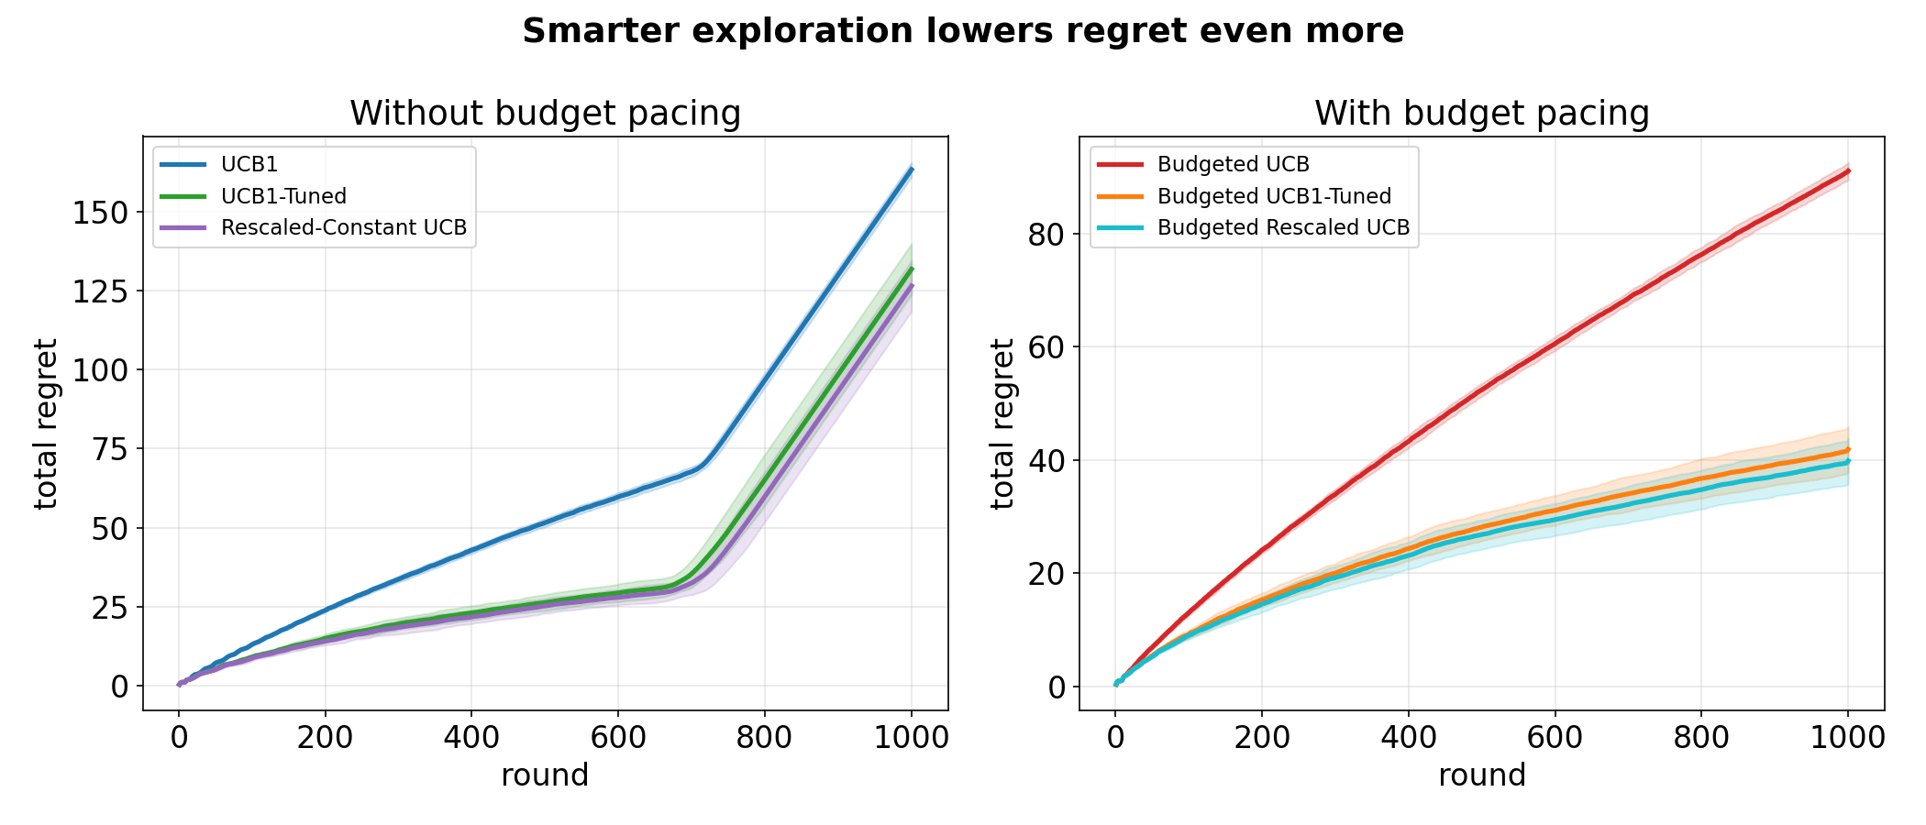
Smarter Exploration Helps Even More
each formula (without budget pacing), plus the same 1,000-round test
~20% lower
~55% lower
regret without budget pacing
regret with budget pacing

Slide 6
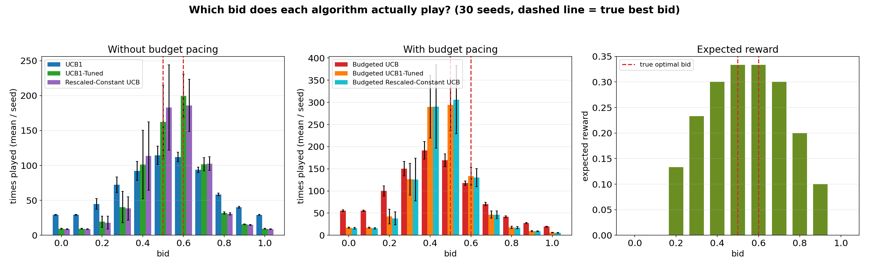
What Bid Does Each Algorithm Actually Learn?
1,000 rounds · budget = 300 · all six algorithms · averaged over 30 runs
The true best bid is 0.5 (tied with 0.6). Without budget pacing, UCB1-Tuned and Rescaled-Constant
UCB land on it about 52% of the time, versus 32% for plain UCB1 — the same gap shows up with
budget pacing too (43% vs. 29%). That is why the smarter versions had lower regret.

Slide 7
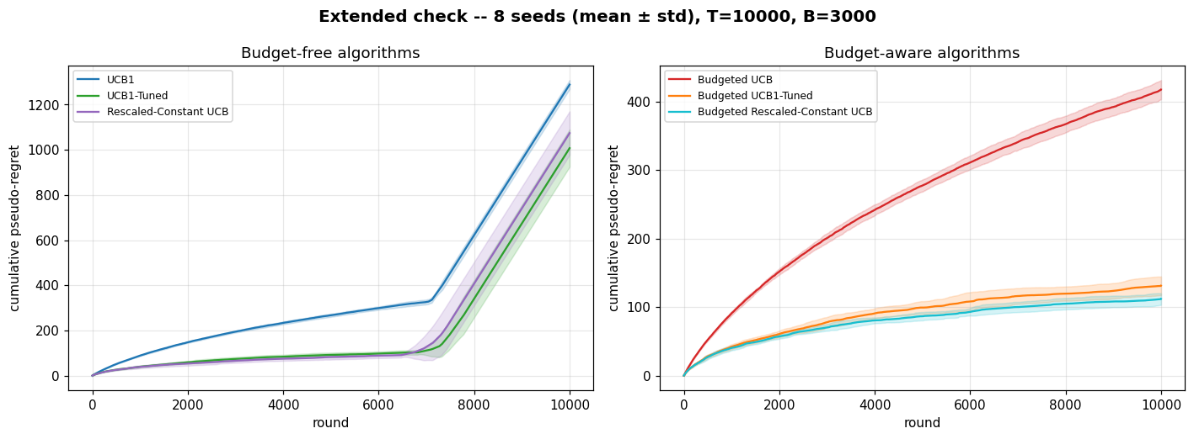
More Rounds Confirm Real Learning
same test scaled up: 10,000 rounds, budget = 3,000
The lines become flatter and flatter over time. A flatter line means less new regret each
round — this confirms that every algorithm is really learning.

Slide 8
Main Takeaways
1
Planning the budget matters most
It cuts total regret in half, and matters even more when money is limited.
2
Smarter exploration adds more gains
UCB1-Tuned and the rescaled version both learn the best bid faster.
3
The learning is confirmed
With more rounds, every algorithm's regret curve flattens out.
Thank you.

Slide 9
REQUIREMENT 2
COMBINATORIAL UCB
for multi-campaign bidding

Slide 10

Goal & Setting
First the aim and the objects; then the rules, the benchmark, the algorithm, the results
01 · THE SETTING
5 campaigns, 1000 rounds, 1 budget
We run N = 5 advertising campaigns for T = 1000 rounds, sharing one budget B = 850. Each round, every campaign we enter is a first-price auction against a rival bid drawn from a Multivariate Gaussian: per-campaign means (0.44, 0.58, 0.48, 0.60, 0.56), std 0.1, clipped to [0,1]
02 · THE MOVES
Arms and super-arms
An arm is one (campaign, bid) pair, bids on the grid {0, 0.1, ..., 1}: 55 arms in total. A super-arm is the set of campaigns played in one round, one bid each. A conflict graph forbids some pairs: next slide.
03 · THE GOAL
Max reward, budget safe
A win earns v = 1 and costs the bid. The aim: maximize total reward over the 1000 rounds, never exceed the budget (0.85 per round on average; results over 20 seeds), always play allowed super-arms.
OBJECTIVE
In one line: earn as much as possible, never exceed the budget, never play a forbidden pair.
REQ 2 · COMBINATORIAL UCB
2/18

Slide 11
Conflict graph and feasible super-arms
Edges are incompatible campaign pairs; a super-arm is feasible only if it contains no edge.
0
Blocked
{0,1}, {1,2}, {2,3}, {3,4}, {4,0}
Adjacent campaigns cannot run in the same round.
4
1
Feasible
Singletons: {0}, {1}, {2}, {3}, {4}
Non-adjacent pairs: {0,2}, {0,3}, {1,3}, {1,4}, {2,4}
3
2
These 10 sets are the super-arms our policy learns.
Forbidden pairs are the five cycle edges.
The learner and the oracle use the same feasible super-arm set, so regret is measured on the same action space.
4

Slide 12
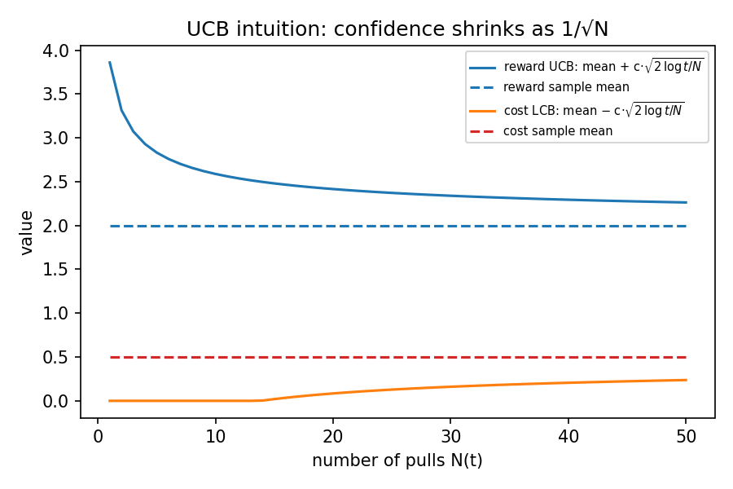
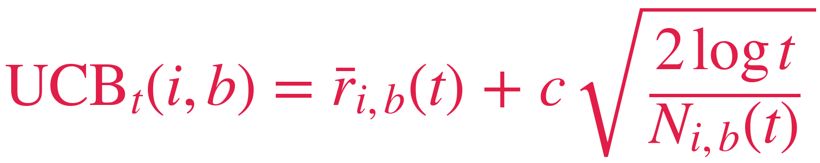
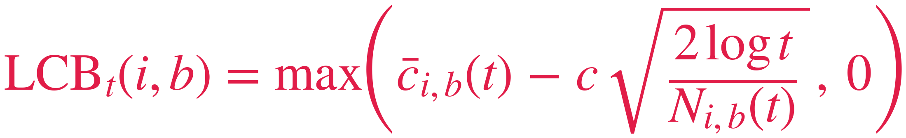
The Algorithm
Our answer: learn at ARM level, decide at SUPER-ARM level
01 · WARM-UP (ROUNDS 1-55)
Arms play alone
Each of the 55 arms is played once, as a singleton, so every arm gets one real observation. No sets yet: this phase is pure arm level.
02 · EACH ROUND · ARM LEVEL
Score every arm
Every arm gets two scores from its own history: UCB = average reward + w (optimistic) and LCB = average cost − w (careful). The bonus w shrinks as the arm is tried. Formulas below.
03 · EACH ROUND · SUPER-ARM LEVEL
Combine and play
Here the sets enter the game: every feasible set is scored by SUMMING the UCBs of its arms; sets failing the three budget checks are dropped; we play the argmax, usually a non-adjacent pair.
04 · AFTER THE ROUND
Update the arms
We observe win/lose for each campaign played, never the rival bid (semi-bandit): untried bids teach us nothing, which is why we must explore. We update ONLY the played arms
CONFIDENCE WIDTH SHRINKS AS 1/√N(T)
REWARD INDEX (UPPER CONFIDENCE)
Optimism makes the learner explore under-sampled but potentially profitable arms.
COST INDEX (LOWER CONFIDENCE)
Pessimism on cost stops a few lucky cheap rounds from fooling the budget filters.
REQ 2 · COMBINATORIAL UCB
5/18

Slide 13
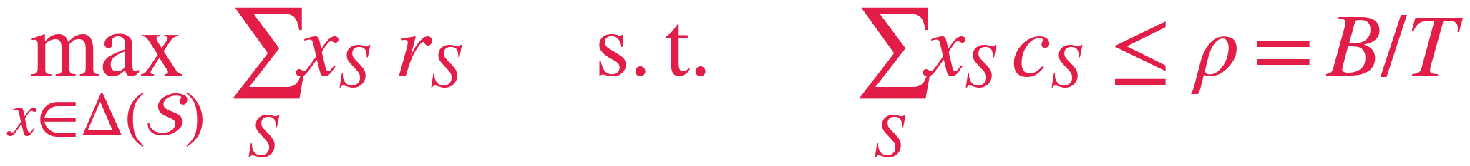
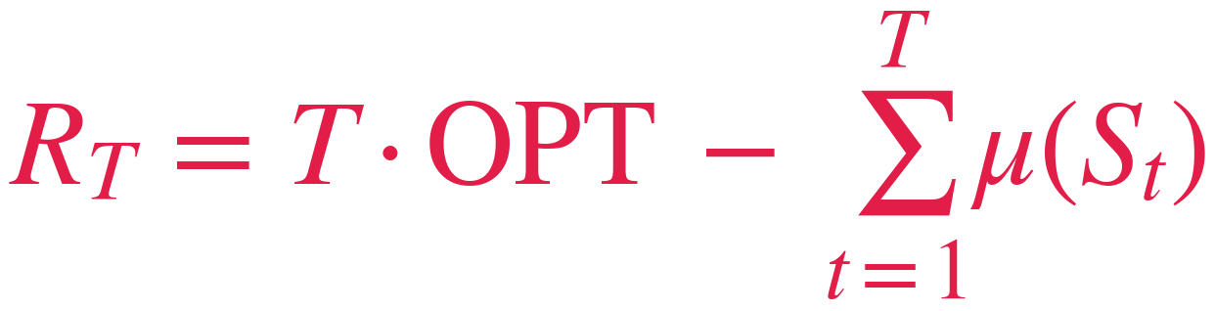
Clairvoyant & Regret
The yardstick: the best mixed policy that fits the budget rate
1 · FULL KNOWLEDGE
2 · LINEAR PROGRAM
3 · VALUE
The clairvoyant knows the true market distribution, so for every (campaign, bid) it computes the exact expected reward (v − b) · p(b) and cost b · p(b): it is handed the table the learner must estimate from wins and losses.
The variables x(S) form a distribution over feasible super-arms: the LP finds the best mix whose expected per-round cost stays within ρ = B/T = 0.85, so expensive rounds can be balanced by cheap ones.
OPT = 0.705 per round
The best fixed super-arm within the cap reaches 0.65 (the cheapest pair {0,2}). The 0.053 difference is the value of mixing: a structural gap that no policy playing one super-arm per round can close.
PSEUDO-REGRET
The comparator r★ = OPTˢ is the per-round optimum of the budgeted problem (Bandits with Knapsacks). The pseudo-regret is measured on expected rewards, so it is non-negative and monotone non-decreasing: sub-linear growth means the learner is converging.
REQ 2 · COMBINATORIAL UCB
4/18

Slide 14
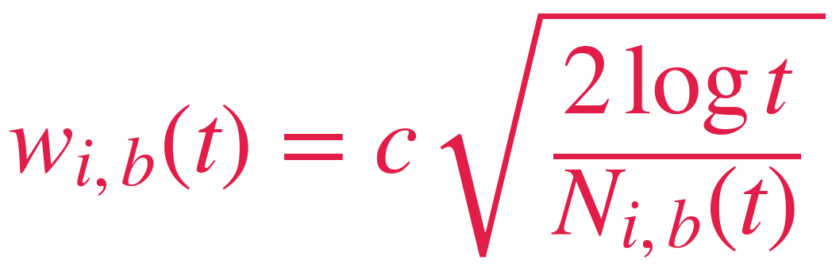
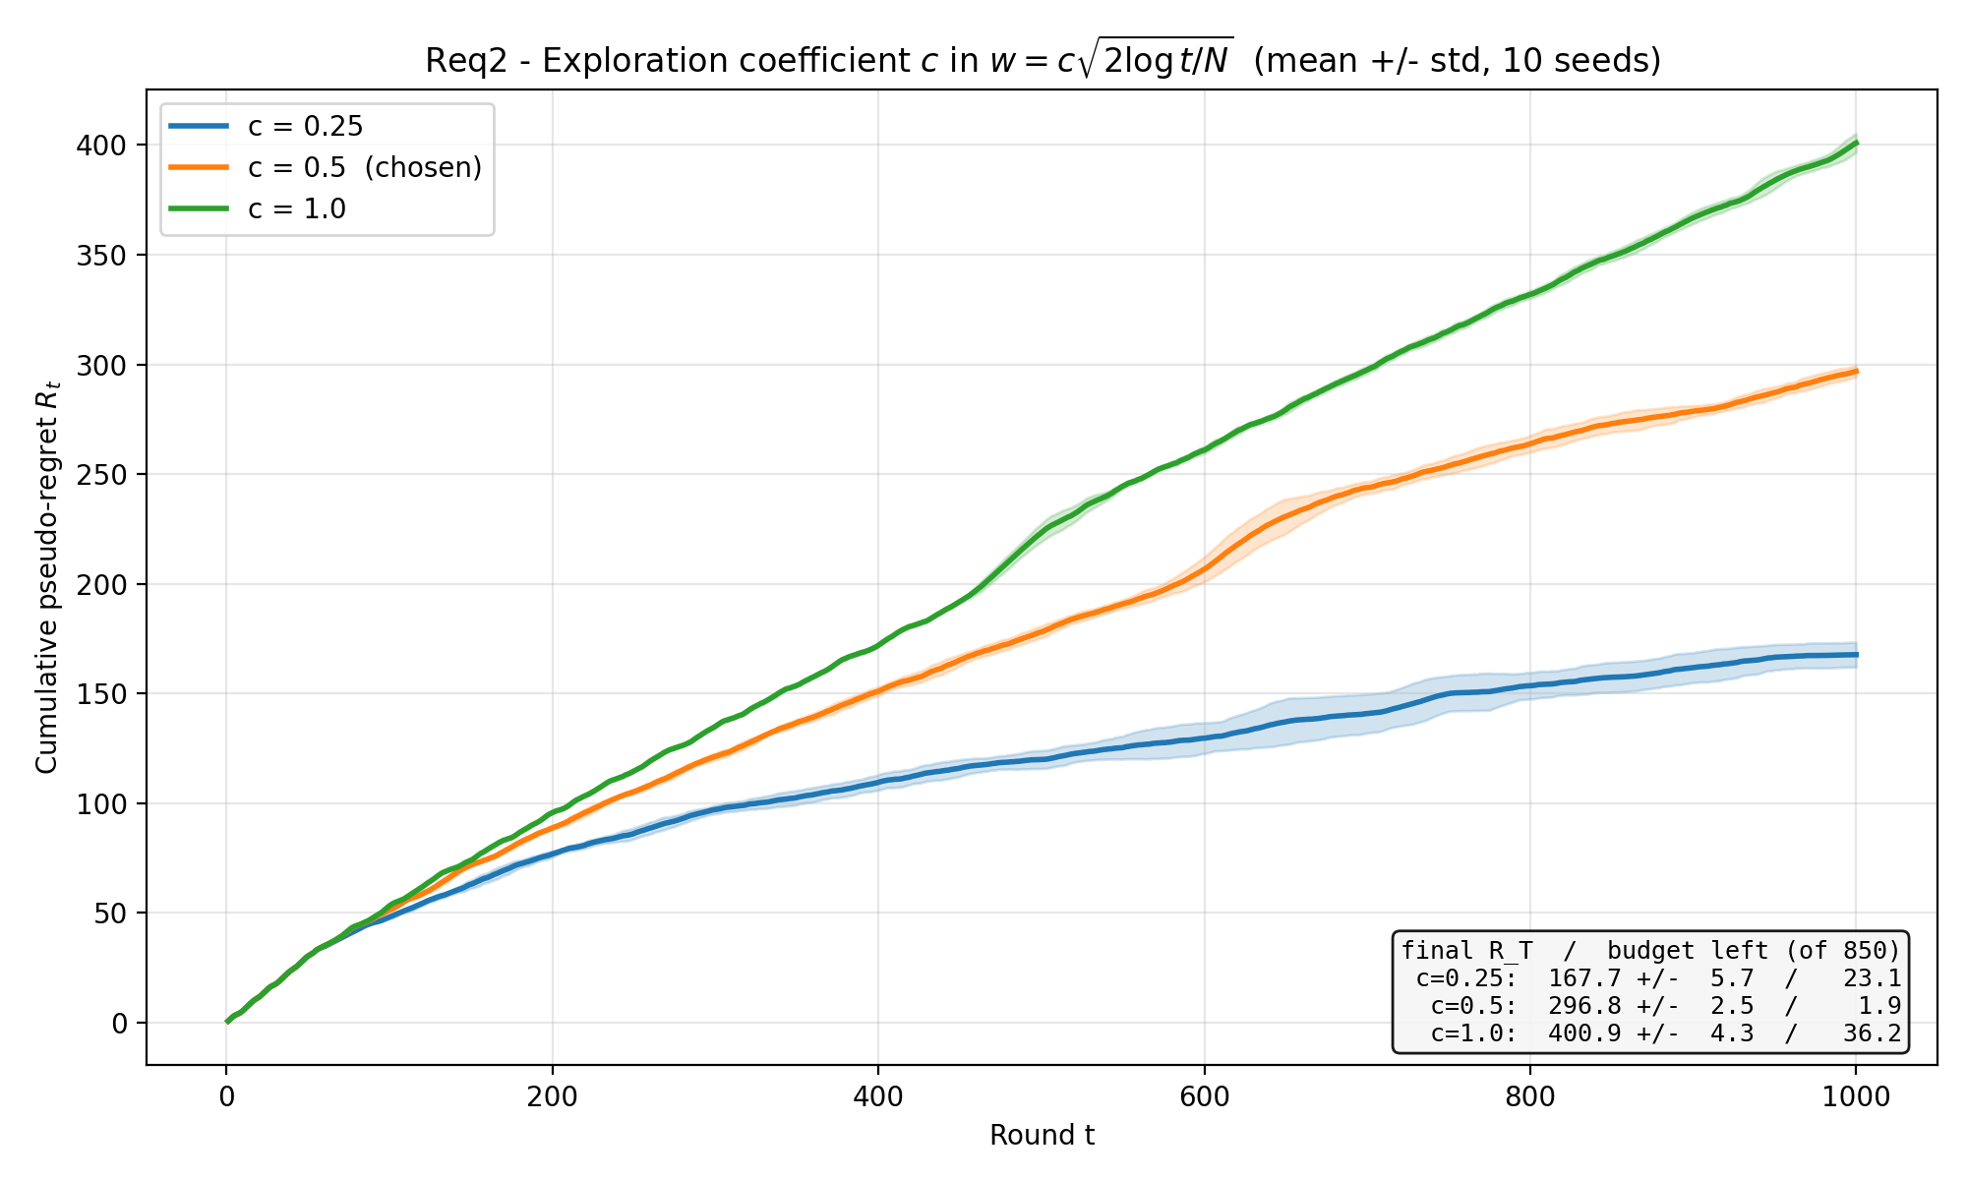
Choosing the exploration coefficient c
A deliberately conservative exploration, and why the textbook c = 1 fails here
CUMULATIVE PSEUDO-REGRET FOR c IN {0.25, 0.5, 1.0}
ROLE IN THE ALGORITHM
Every round the oracle plays the feasible super-arm maximizing Σ (mean + w), so the bonus enters every single selection: c scales how strongly under-sampled arms are favoured.
SWEEP & CHOICE
c: 0.25 / 0.5 / 1.0 ⇒ R_T: 168 / 297 / 401
The textbook bonus is calibrated for rewards spanning [0,1]; here the best arm pays 0.38, so with c = 1 optimism dominates every index and exploration never ends within T = 1000 (regret 401, near-linear).
REQ 2 · COMBINATORIAL UCB
16/18

Slide 15
Summary statistics
The 20-seed run summarised in numbers
20-SEED SUMMARY
REWARD STABILITY
The reward std is ≈ 1.7% of the mean, a tight variance for a stochastic bandit run all the way to T = 1000.
It tells us the good performance is systematic, not a lucky seed.
Metric
Mean
Std
Min
Max
Cumul. reward
405.26
6.94
391.10
416.00
Cumul. cost
848.05
1.85
843.90
850.00
COST STABILITY
Cumul. regret
296.66
3.02
291.71
302.05
A cost std of ≈ 1.9 against an 850 budget shows the pacing logic behaves consistently across every seed.
Spending is reproducible and never overshoots the cap.
Budget left
1.95
1.85
0.00
6.10
REQ 2 · COMBINATORIAL UCB
18/18

Slide 16
Environment req 3 and 4:
The Gaussian Constellation
Extra

Slide 17
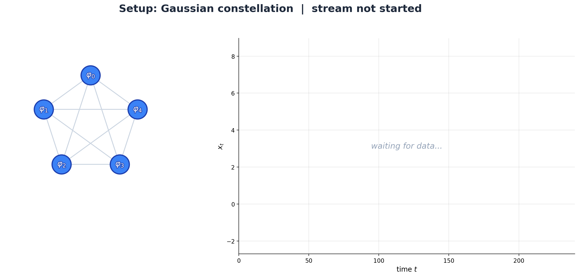

Slide 18
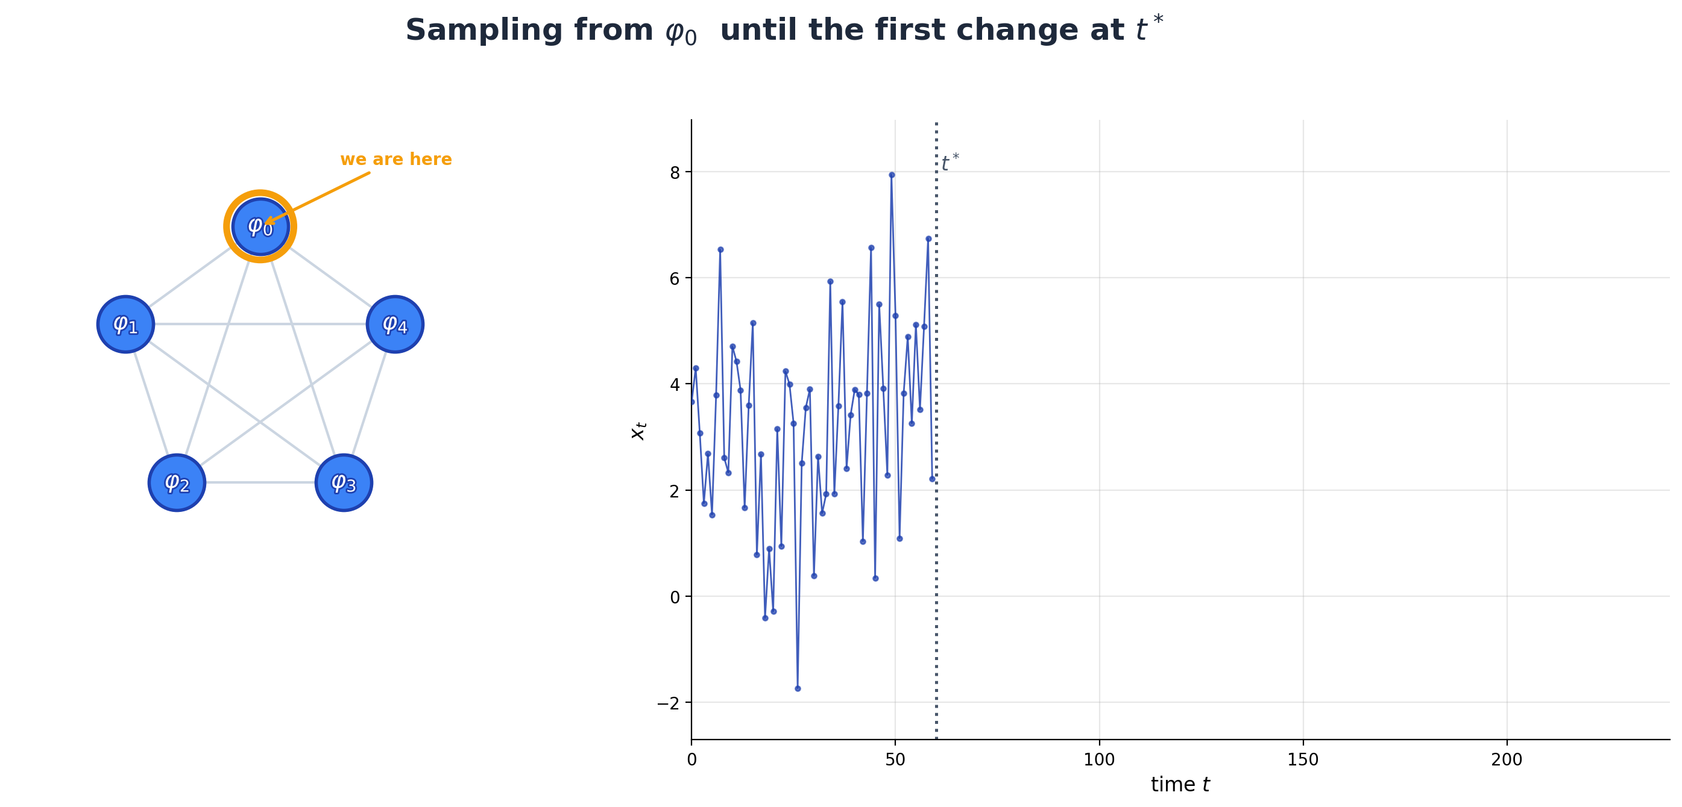

Slide 19
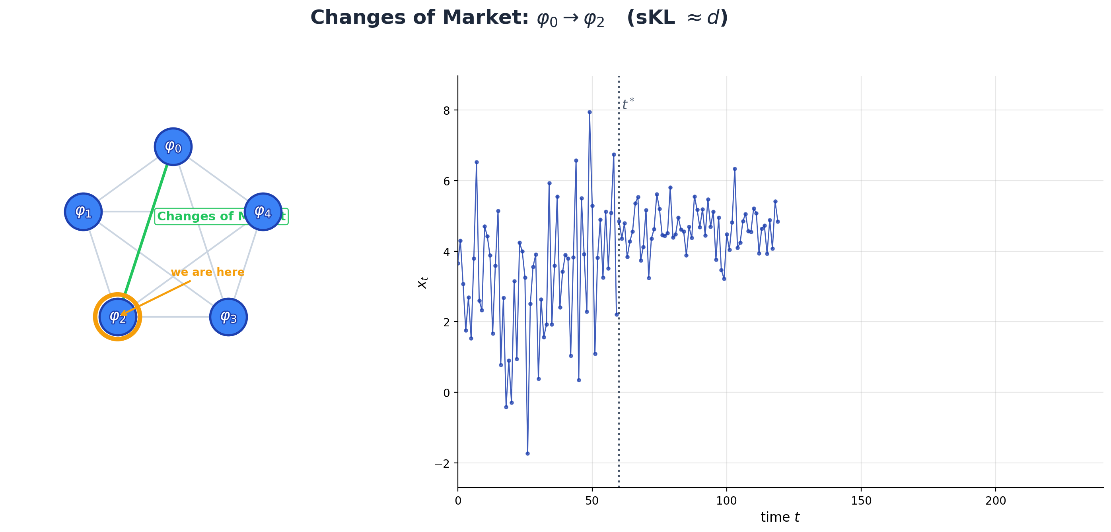

Slide 20
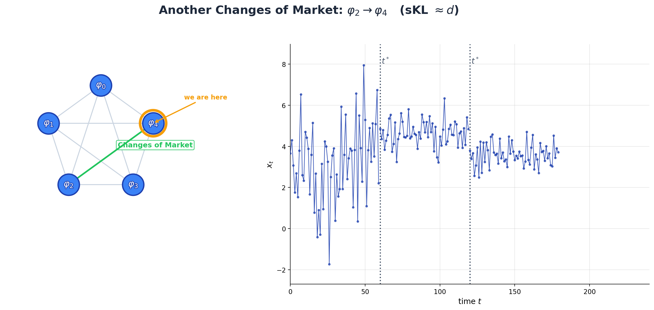

Slide 21
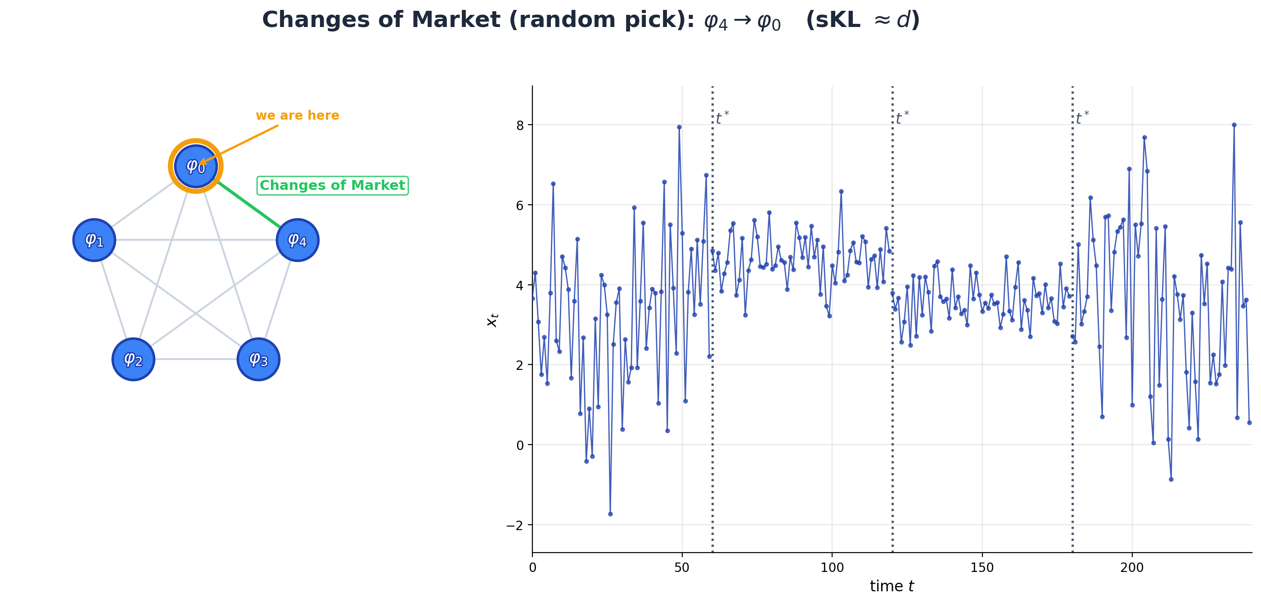

Slide 22
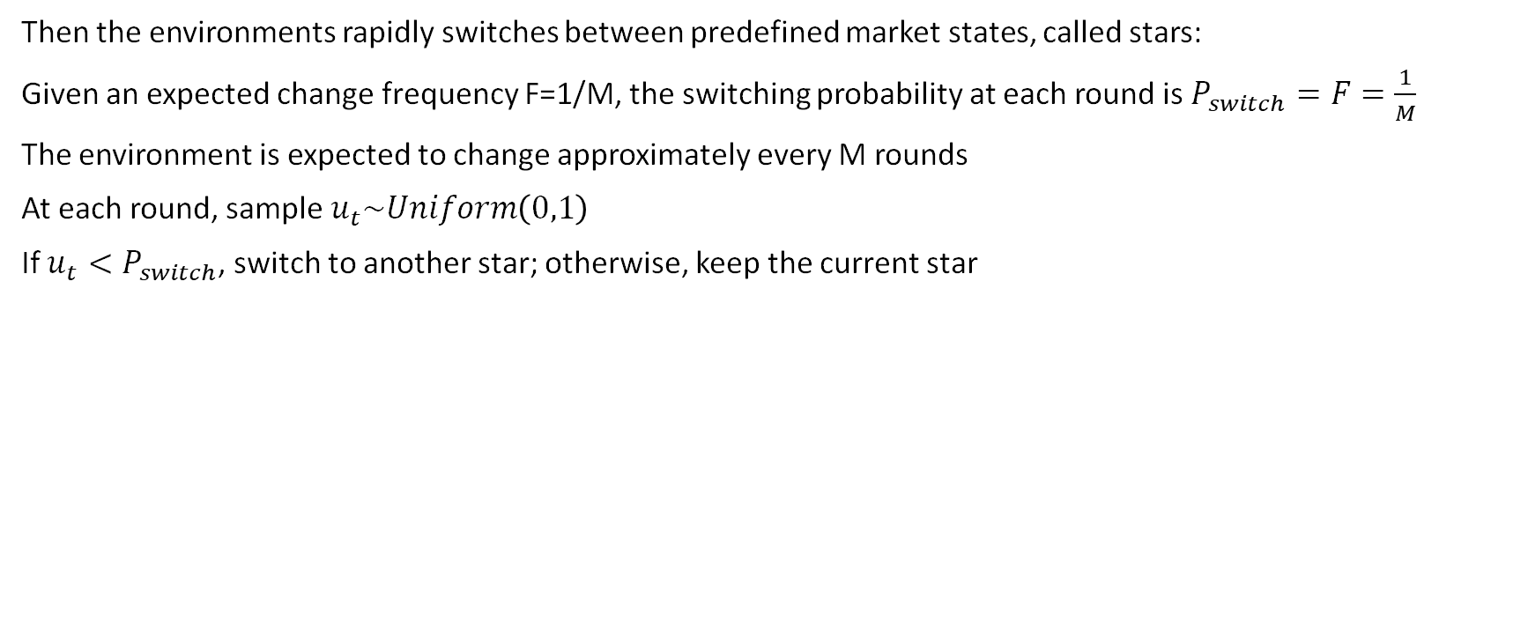
Switching mechanism
Then the environments rapidly switches between predefined market states, called stars:
Given an expected change frequency F=1/M, the switching probability at each round is $P_{switch}=F=\frac{1}{M}$
The environment is expected to change approximately every M rounds
At each round, sample $u_{t}\sim Uniform\left(0,1\right)$
If $u_{t}<P_{switch}$, switch to another star; otherwise, keep the current star

Slide 23
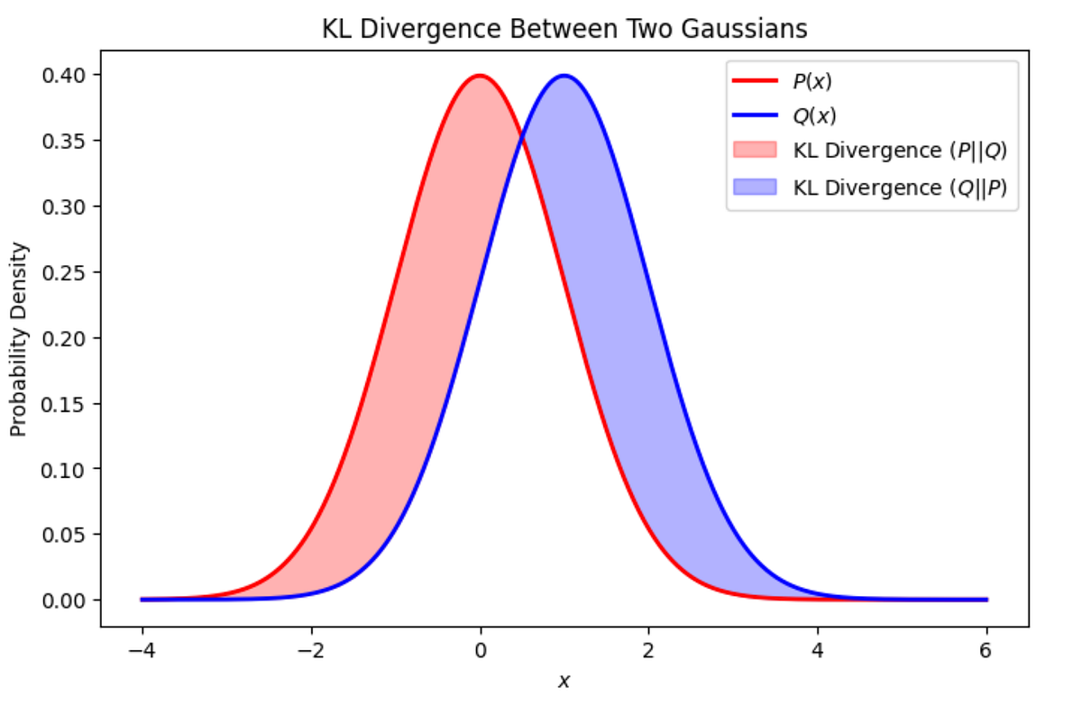
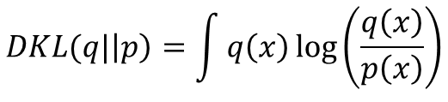
Same sKL
It is crucial that every star (representing a distribution) of our constellation φi has predefined sKL from all the other φj.
WHY?
sKL is a good measure for measuring how adversarial the env is.
Previous works, and Chernoff-Stein Lemma assures us that detection delay of CDT depends on the Kullback–Leibler (KL) divergence.)
$$DKL(q|\left|p\right)=\int{q\left(x\right)\log\left(\frac{q\left(x\right)}{p\left(x\right)}\right)}$$
$D_{sym}(q|\left|p\right)=$ $DKL(q|\left|p\right)+DKL(p|\left|q\right)$

Slide 24
Possible solutions
Use rejection sampling similar + ccm (Generating High-Dimensional Datastreams for Change Detection Diego Carrera, Giacomo Boracchi).
Use OGD : from our experimentation an upgrade to previous existing versions. On the extra material we have a complete performance analysis + theoretical reasons why we think our method is better.
References:
Generating High-Dimensional Datastreams for Change Detection D. Carrera, G. Boracchi
Multimodal Batch-wise Change Detection D. Stucchi, G. Boracchi, L. Magri, D. Carrera*
*Note: this paper imposed just a lower bound on the SKL divergence.

Slide 25
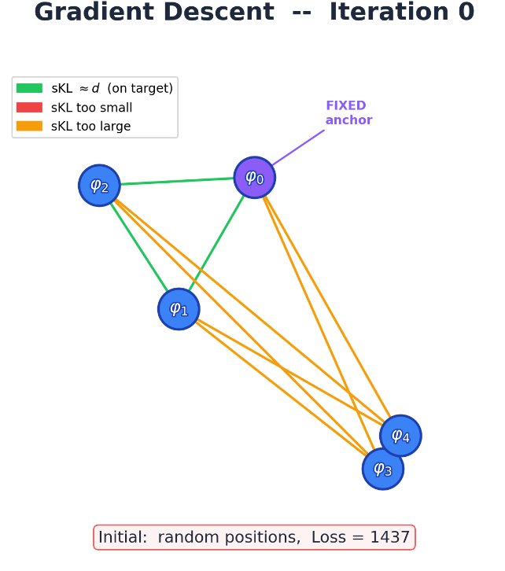
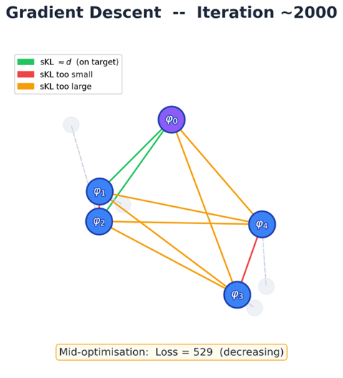
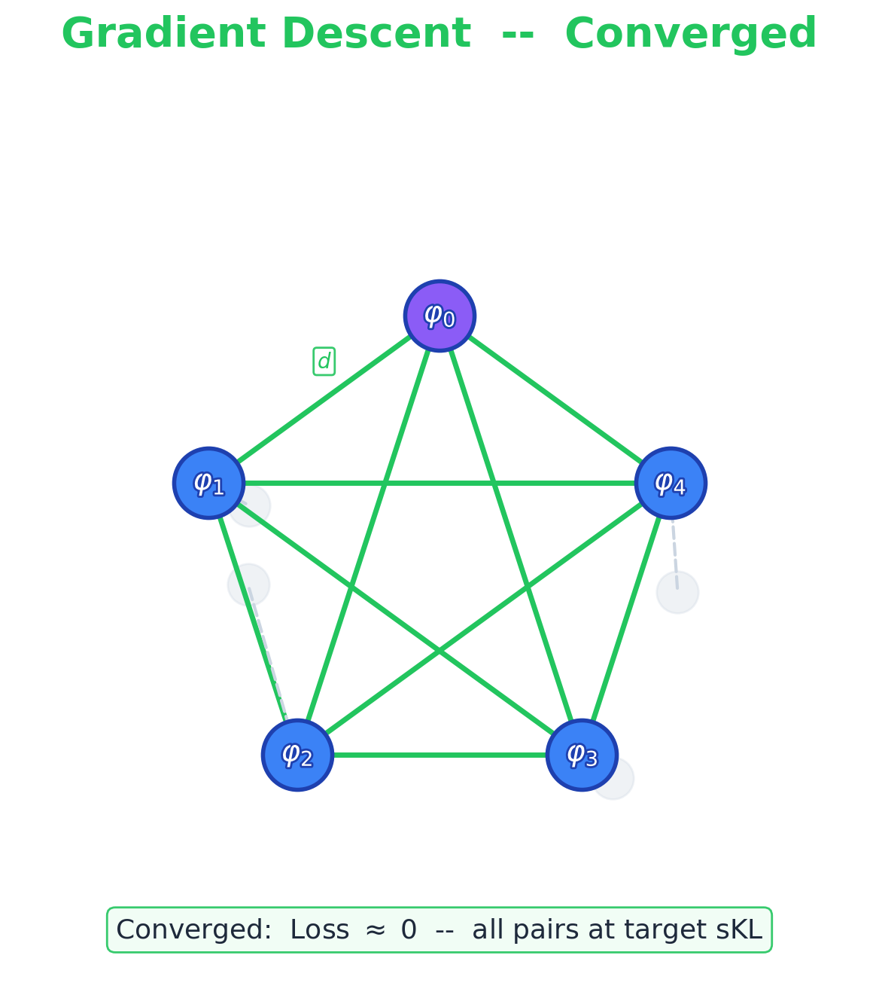
Online Gradient descent
Instead of adding a mode one by one at the beginning we randomly distribute the parameter of all N of our gaussians and then we manipulate the gaussians to slowly converge to the solution.
Anchor could be a gaussians with good values of mean and std dev.

Slide 26
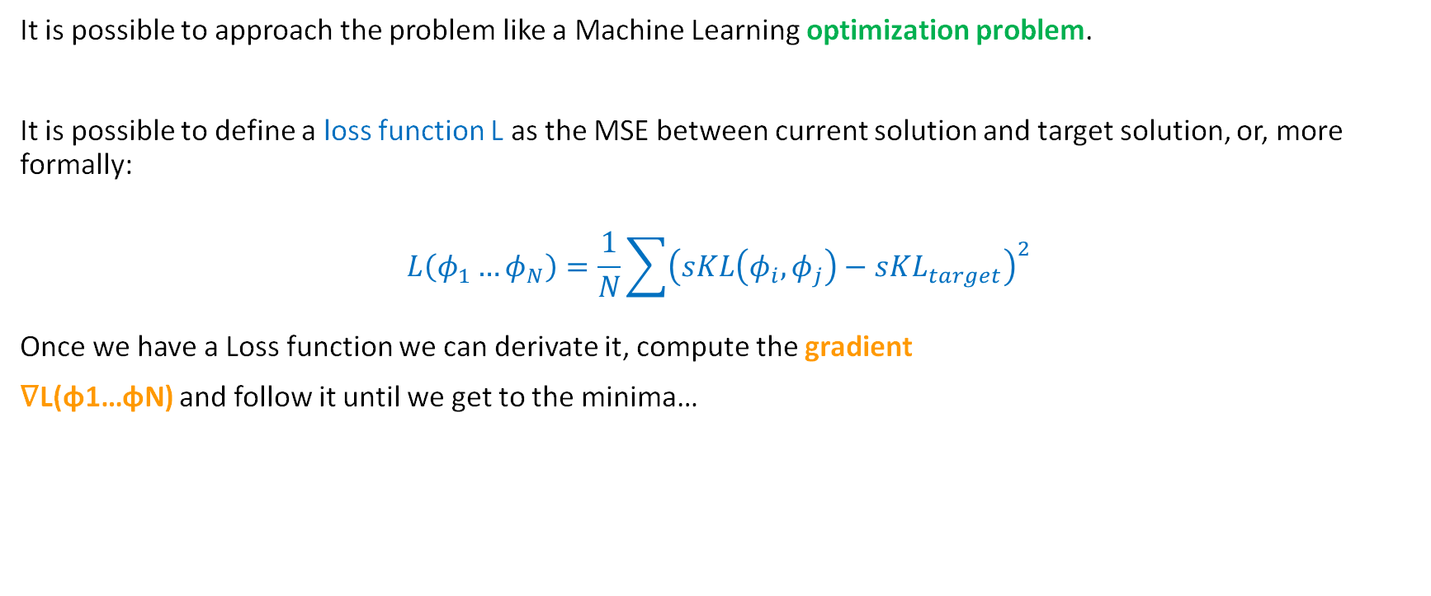
How it works
It is possible to approach the problem like a Machine Learning optimization problem.
It is possible to define a loss function L as the MSE between current solution and target solution, or, more formally:
$$L\left(φ_{1}…φ_{N}\right)=\frac{1}{N}\sum{{\left(sKL\left(φ_{i},φ_{j}\right)−sKL_{target}\right)}^{2}}$$
Once we have a Loss function we can derivate it, compute the gradient
∇L(φ1…φN) and follow it until we get to the minima…

Slide 27
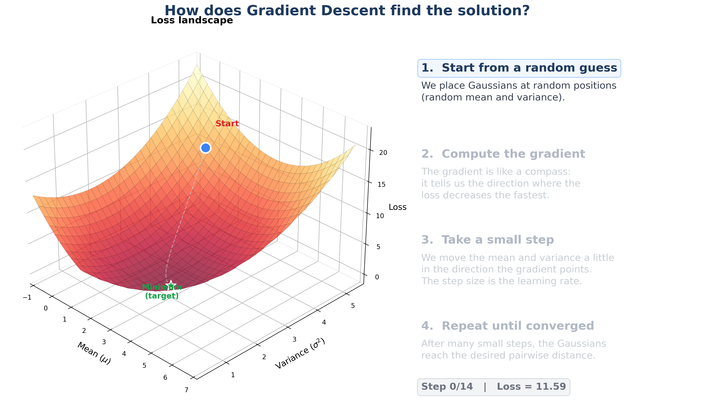

Slide 28
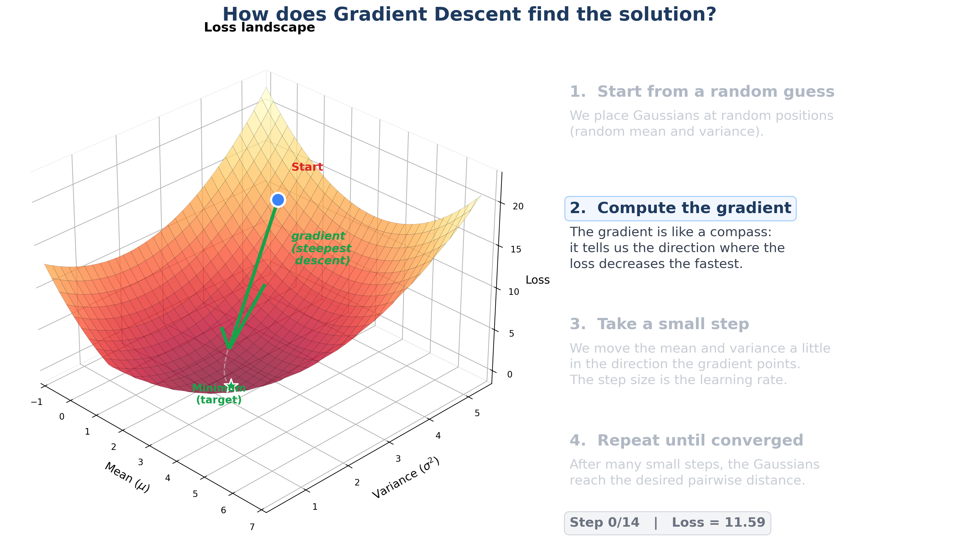

Slide 29
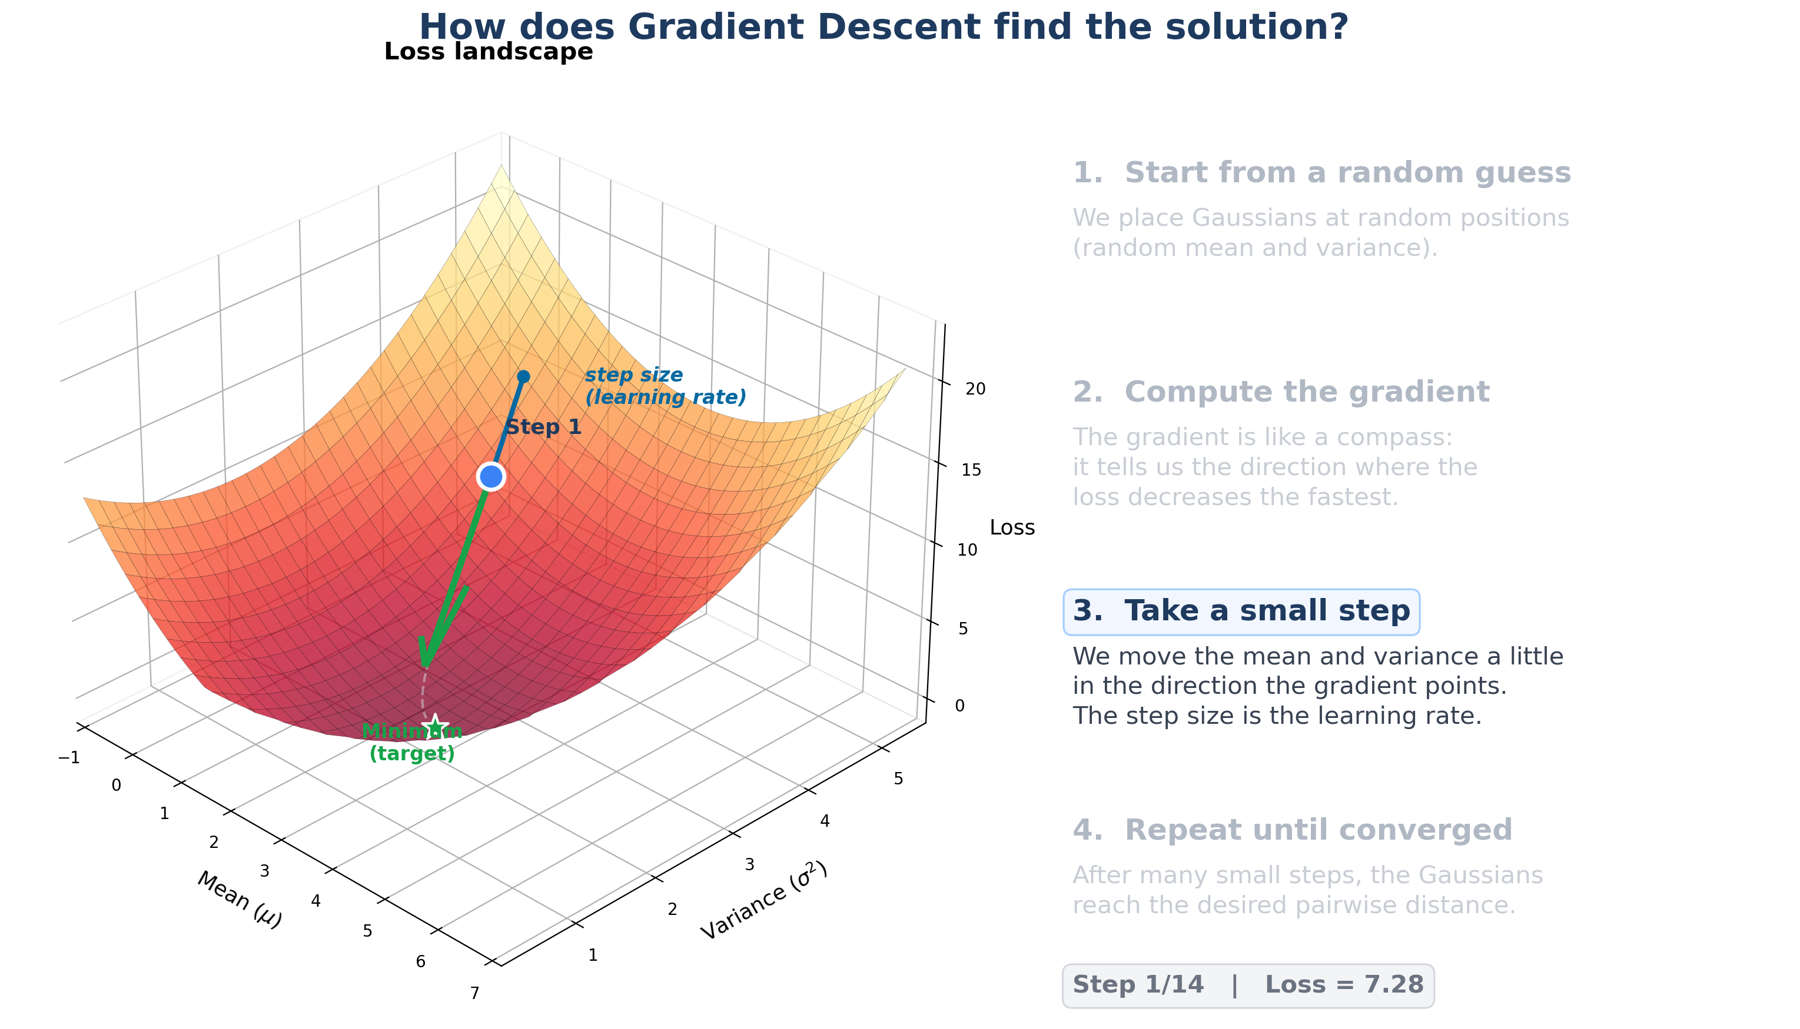

Slide 30
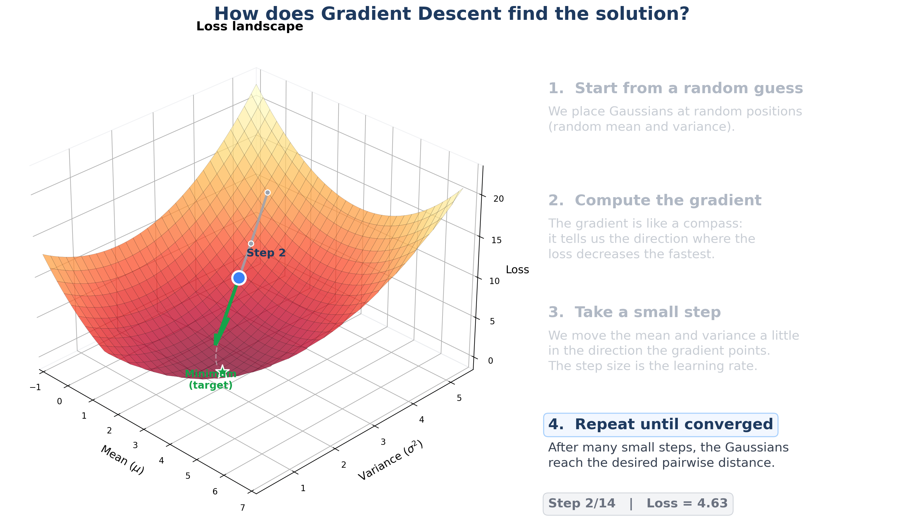

Slide 31


Slide 32


Slide 33


Slide 34
EXPERIMENTAL STORY
Where each algorithm wins
Regret ratio CUCB+CDT / Primal-dual across the (f, sKL) plane
high
COLOR ENCODING
REQ 4
REQ 3
regret ratio CUCB+CDT / Primal-dual
CDT wins
Primal-dual wins
CDT wins
tie
Primal-dual wins
Bottom band (low sKL)
sKL between regimes
Drift is undetectable by anyone. Both methods perform similarly — Req 2 territory.
Top-left (low f, high sKL)
Long stable regimes between sharp changes. CDT detects and adapts — clean Req 4 win.
REQ 2
stationary
Top-right (high f, high sKL)
low
Switches before any window can adapt. Primal-dual's worst-case guarantee shines — Req 3.
low
high
switching frequency f
The transition diagonal
Where one method overtakes the other. The most informative part of the plot.
One plot tells the whole story: the regime where best-of-both-worlds guarantees actually pay off.

Slide 35
Requirement 3: Primal Dual
REQUIREMENT 3

Slide 36
Shared non-stationary market environment
sKL controls how different regimes are; frequency controls how often the regime changes.
1. Three Gaussian modes
2. Separation between modes
z_{t} ∈ {0, 1, 2}, m_{t} ~ N(μ_{zₜ}, Σ_{zₜ})
sKL(P_{a}, P_{b}) ∈ {20, 200, 500}
Each mode is a 5-dimensional distribution of competing bids.
Larger sKL means a more visible distribution shift.
3. Stochastic mode switching
4. Freeze the realized market
Pr(z_{t} ≠ z_{t−1}) = p
M = [m₁, ..., m_{T}]⊤ ∈ [0, 1]^{3000×5}
p = 1/1500, 1/200, or 1/25; larger p gives more change points.
Once sampled, this exact matrix is reused by every algorithm.
EXAMPLE PATH
Mode 0
Mode 2
Mode 1
Mode 0
round
5

Slide 37
Experiment setting
Fixed parameters and the 3 x 3 grid used for the Req3 empirical evaluation.
SHARED BASE
SEPARATION SKL
CHANGE PROB. P
REPLICATIONS
T=3000, N=5
20 / 200 / 500
1/1500 / 1/200 / 1/25
R=10 per cell
B=2500; 11 bid levels
low, medium, high
low, medium, high frequency
90 runs in total
3 x 3 experimental grid
One cell = one setting with 10 shared realizations
Symmetric KL separation
sKL 20
sKL 200
sKL 500
p = 1/1500
10 realizations
10 realizations
10 realizations
low frequency
The learner receives the precomputed $m_{t}$ sequence; learner randomness does not regenerate $q_{t}$ or the market stream.
p = 1/200
10 realizations
10 realizations
10 realizations
medium frequency
p = 1/25
10 realizations
10 realizations
10 realizations
high frequency
The grid is designed to separate the effect of regime separation from the effect of change frequency.
3

Slide 38
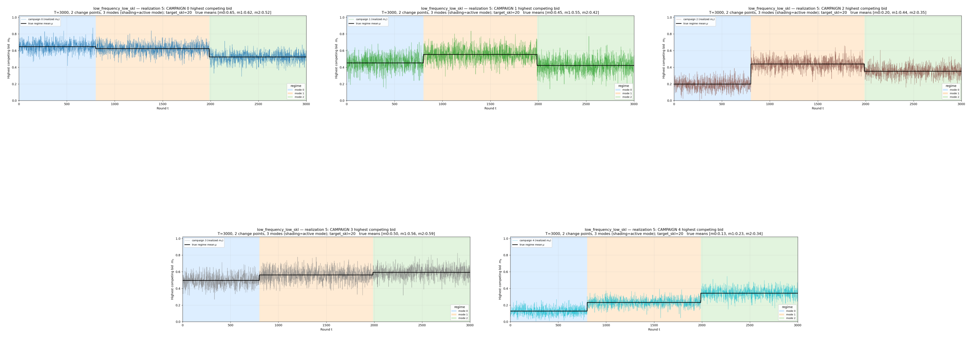
Case 1: Low Frequency Low SKL
ONLINE LEARNING APPLICATIONS · REQUIREMENT 4
ola/environments/non_stationary.py · ola/utils/constellation

Slide 39
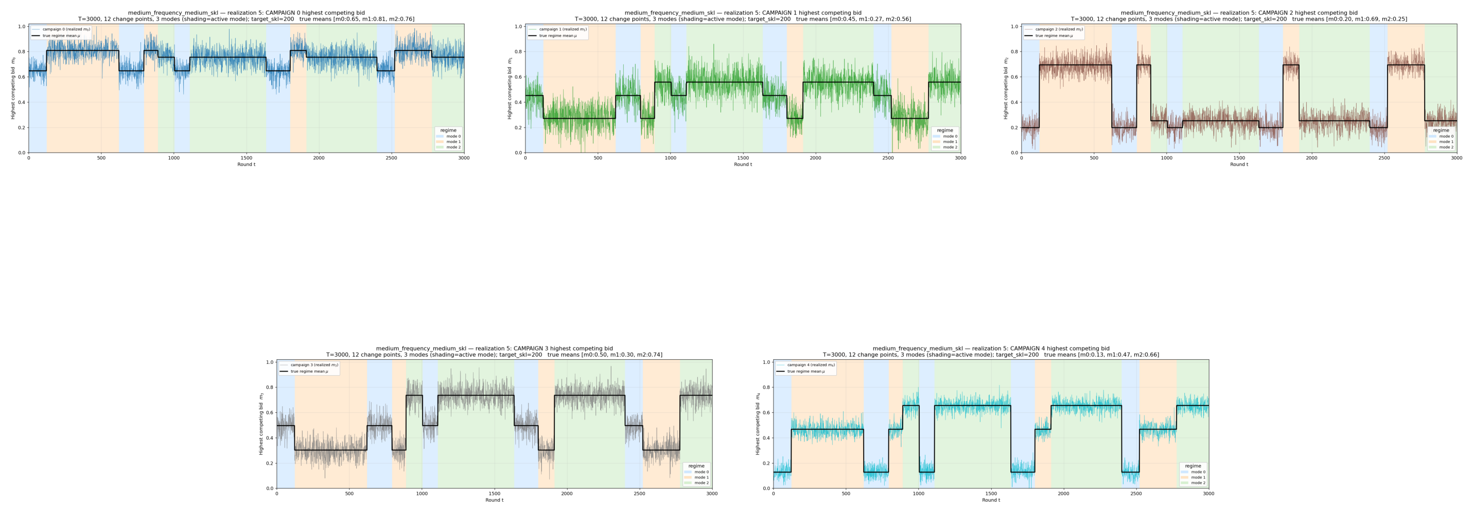
Case 4: Medium Frequency Medium SKL
ONLINE LEARNING APPLICATIONS · REQUIREMENT 4
ola/environments/non_stationary.py · ola/utils/constellation

Slide 40
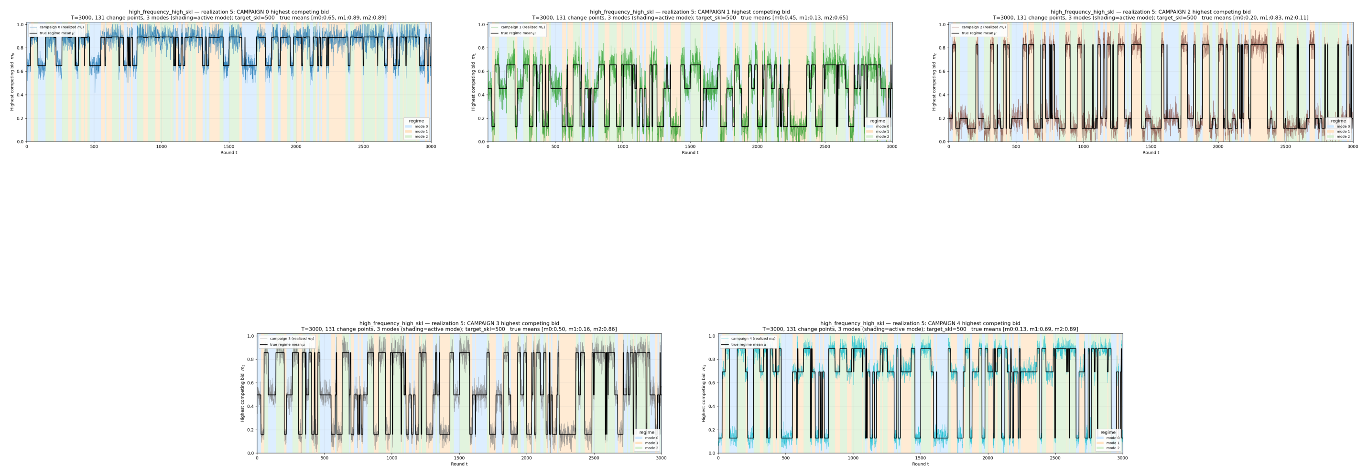
Case 9: High Frequency High SKL
ONLINE LEARNING APPLICATIONS · REQUIREMENT 4
ola/environments/non_stationary.py · ola/utils/constellation

Slide 41
Algorithm: factorized primal-dual Hedge
Hedge-style primal update with a projected dual price for the budget constraint.
ALGORITHM
Input: feasible super-arms set 𝒜, bid grid 𝒢, budget B, rates η and ηλ
Primal update
1
Initialize q₁(S)=1/|𝒜|, p₁,ᵢ(g)=1/|𝒢|, and λ₁=0.
Same idea as Hedge in the lectures: normalize weights, then multiply by an exponential score factor.
2
For each round t = 1 to T:
3
Draw Sₜ ~ qₜ and bids gₜ,ᵢ ~ pₜ,ᵢ for active campaigns i ∈ Sₜ.
Dual update
4
Observe the full market vector mₜ and evaluate every campaign-bid arm.
Projected gradient step on the budget multiplier. If spending exceeds the target pace ρ, λ increases.
5
Compute Lagrangian scores: zₜ,ᵢ(g) = uₜ,ᵢ(g) − λₜ cₜ,ᵢ(g).
6
Aggregate super-arm score: Zₜ(S) = ∑ᵢ∈S z̄ₜ,ᵢ.
Full feedback
7
Hedge update: qₜ₊₁(S) ∝ qₜ(S) exp(η Zₜ(S)).
Because mₜ is observed, all campaign-bid scores are available. No EXP3 importance-weighted estimator is needed.
8
Bid update: pₜ₊₁,ᵢ(g) ∝ pₜ,ᵢ(g) exp(η zₜ,ᵢ(g)).
9
Dual update: λₜ₊₁ = Π[0,1/ρ](λₜ + ηλ(Cₜ − ρ)), with ρ=B/T.
z̄ₜ,ᵢ is the bid-level score summarized for campaign i when updating the super-arm distribution.
10
Apply the remaining-budget filter before the next draw.
The hard filter is a safety layer; the learning rule is the Hedge primal update plus projected dual update.
7

Slide 42
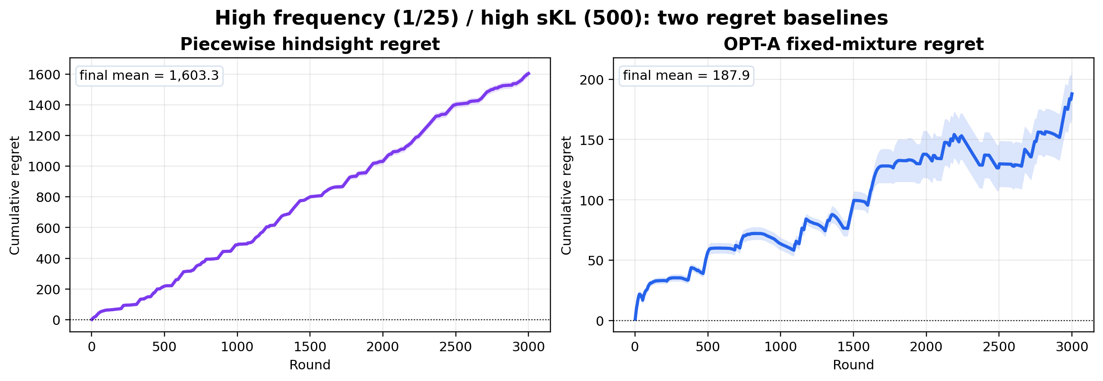
High frequency / high sKL: OPT-A regret
Same setting as diagnostic plot; piecewise is the main benchmark and OPT-A is a small theory check.
CHANGES
PIECEWISE
131
1,603.3
short regimes
final regret
OPT-A
COST
187.9
1,865.0
final regret
below B=2500
Benchmark meaning
Piecewise can switch to the best feasible super-arm in each regime. OPT-A chooses one fixed randomized action after the full sequence, so it cannot switch across regimes.
Large piecewise regret comes from chasing many short-regime optima, not from budget violation; OPT-A is smaller because its comparator is fixed.
28

Slide 43
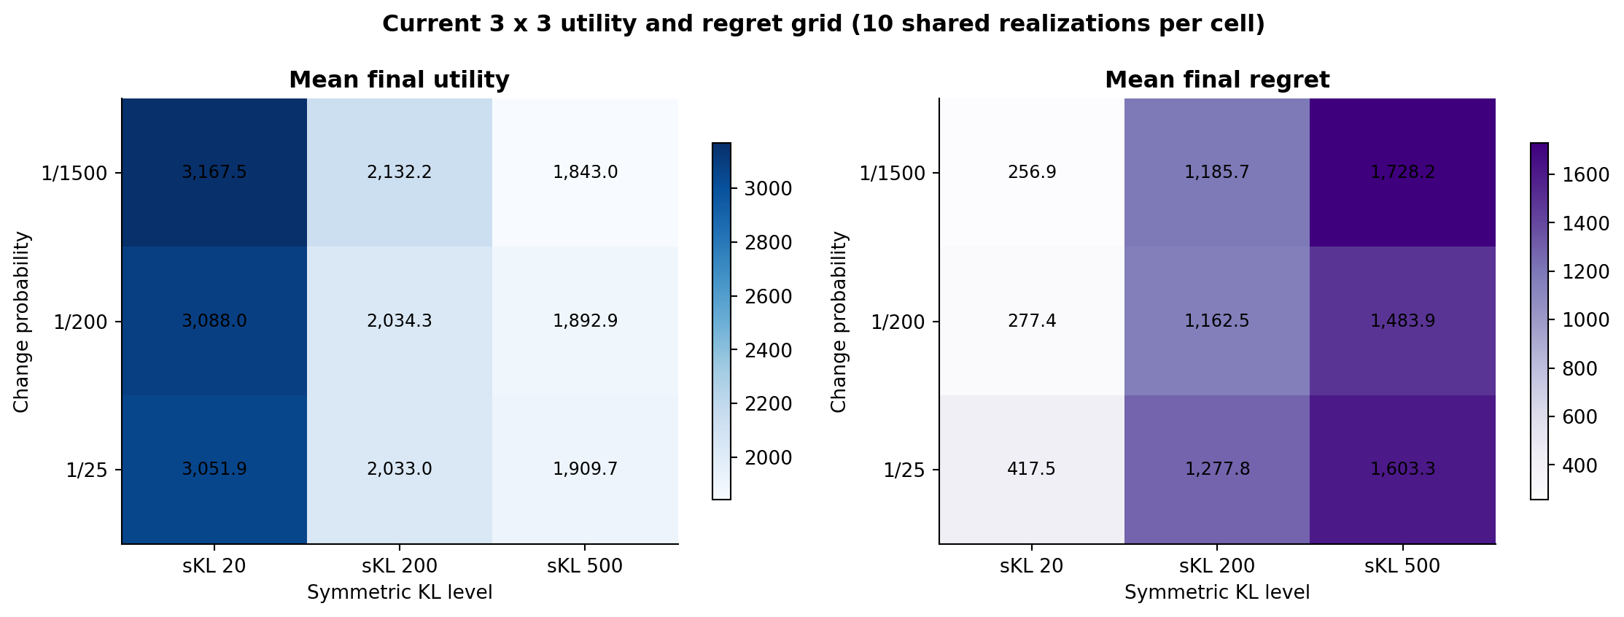
Utility and regret across the full grid
Each cell is a mean over 10 shared realizations; uncertainty is shown in the detailed diagnostics.
13

Slide 44
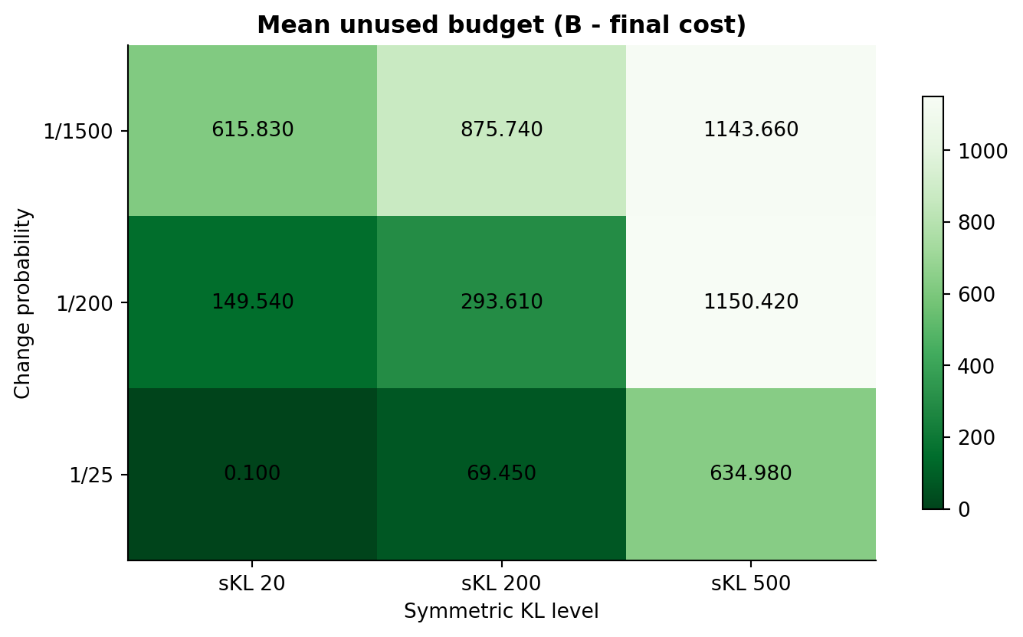
Budget feasibility in every setting
The hard filter keeps realized cumulative cost at or below B=2500 in all 90 runs.
MAXIMUM COST
2,499.90
MINIMUM COST
1,283.10
VIOLATIONS
0 / 90
14

Slide 45
Req 4: Slightly NSE
REQUIREMENT 4
Sliding window and Change detection test

Slide 46
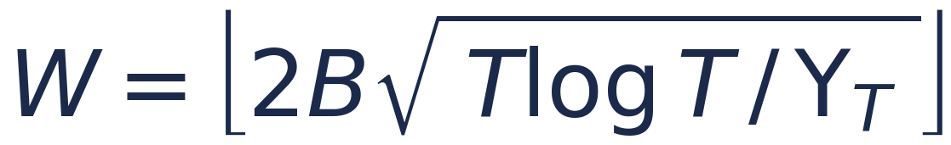
REQUIREMENT 4 · SLIGHTLY NON-STATIONARY ENVIRONMENT
Combinatorial-UCB with Sliding Window
The idea. When the distribution of competing bids changes over time, old observations describe a regime that no longer holds. Standard Combinatorial-UCB averages over the whole history and adapts too slowly. SW-CUCB keeps the CUCB machinery but trusts only the most recent W rounds.
How it works
Windowed exploration
The exploration term of each arm's UCB estimate now uses only its last W samples, not its full history:
UCB = μ̂ + √( c·log(min(t,W)) / n )
μ̂, n : mean & pull count over the last W rounds c : exploration coeff.
▪ Windowed estimates: reward mean, cost mean and pull counts are computed from the last W rounds only; older observations are evicted as the window slides.
▪ Windowed bonus: the confidence width uses log(min(t, W)) instead of log(T) — exploration is calibrated to the data the window can hold.
▪ Low exploration coefficient c: set well below the classical 2.0. Rewards values lie in [0, 1], so the standard bonus would dwarf the estimated means; a smaller c keeps the exploration term from always dominating the UCB, so the learner genuinely exploits — not only explores.
▪ Passive adaptation to changes: after a change, arms whose window empties get a wide optimistic bonus and are re-explored automatically — no explicit reset needed.
window size
W ≈ √T default, number of changes unknown
from B, T, Υ_T
too large → slow adaptation · too small → noisy estimates
ola/algorithms/sw_cucb.py

Slide 47
REQUIREMENT 4 · SLIGHTLY NON-STATIONARY ENVIRONMENT
Experiments Environments
Disclaimer for the Considered Cases for the Experiments
Since the specification required a slightly non-stationary environment for the requirement 4 assignment, we decided to test, firstly, the sliding window and change detection algorithms in ideal scenarios, in order to show the desired, sub-linear, behaviour of the many approaches.
Then, the same algorithms have been tested also in more highly non-stationary environments, used at the same time for the comparison between requirement 4 and requirement 3 different algorithms. In the final cases shown, the environment exhibits a much higher frequency for the highest competing bids Gaussian distributions.
Slightly non-Stationary Environment
Time horizon T
Intervals
Budget B
Per-round budget ρ = B / T
4000
3
8000
2.0
In particular, the time horizon is divided into 3 equal intervals; and the related change points occur at round 1333 and 2666.
ola/algorithms/sw_cucb.py

Slide 48
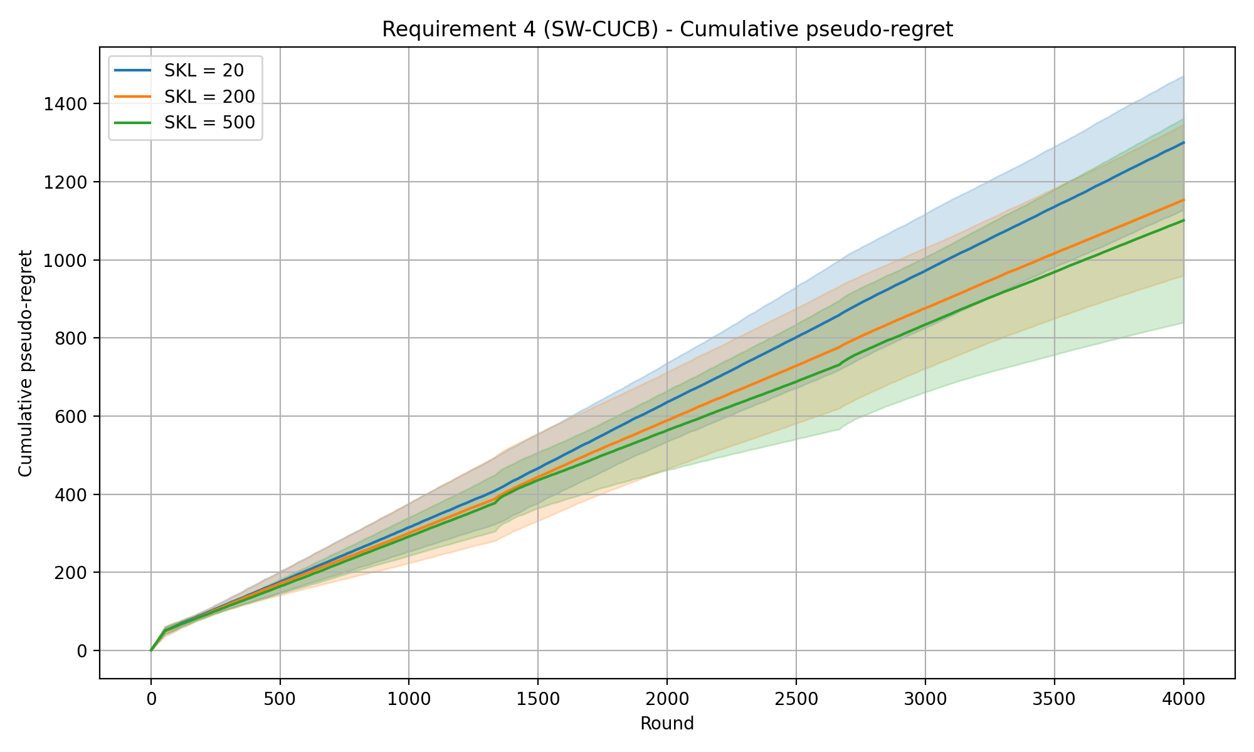
REQUIREMENT 4 · SLIDING-WINDOW CUCB · EXPERIMENTS
SW-CUCB — cumulative pseudo-regret
Experiment setup
Time horizon T
Intervals
Budget B
Per-round budget ρ = B / T
Exploration coeff. c
Window size W = √T
4000
3
8000
2.0
0.1
63
SKL levels (curves) 20 / 200 / 500
Shaded bands: mean ± std across 20 repeated runs.
SW-CUCB · cumReg_3int_DefWin_0.1ec

Slide 49
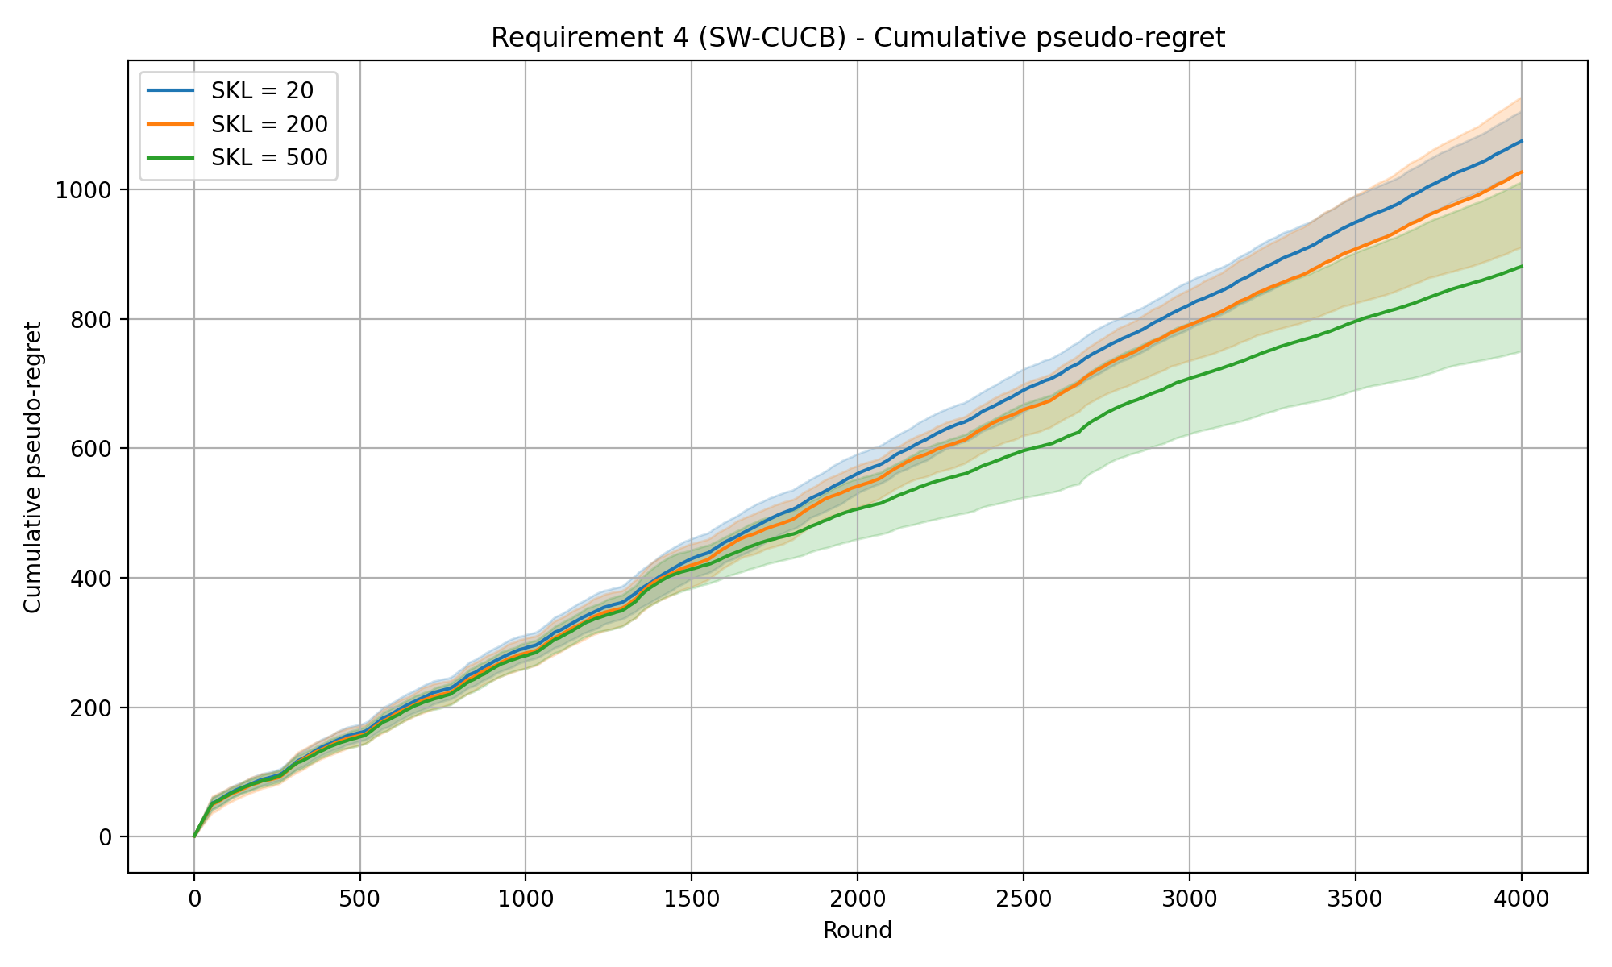
REQUIREMENT 4 · SLIDING-WINDOW CUCB · EXPERIMENTS
SW-CUCB — cumulative pseudo-regret
Experiment setup
Time horizon T
Intervals
Budget B
Per-round budget ρ = B / T
Exploration coeff. c
4000
3
8000
2.0
0.1
257
SKL levels (curves) 20 / 200 / 500
Shaded bands: mean ± std across 20 repeated runs.
SW-CUCB · cumReg_3int_257win_0.1ec

Slide 50
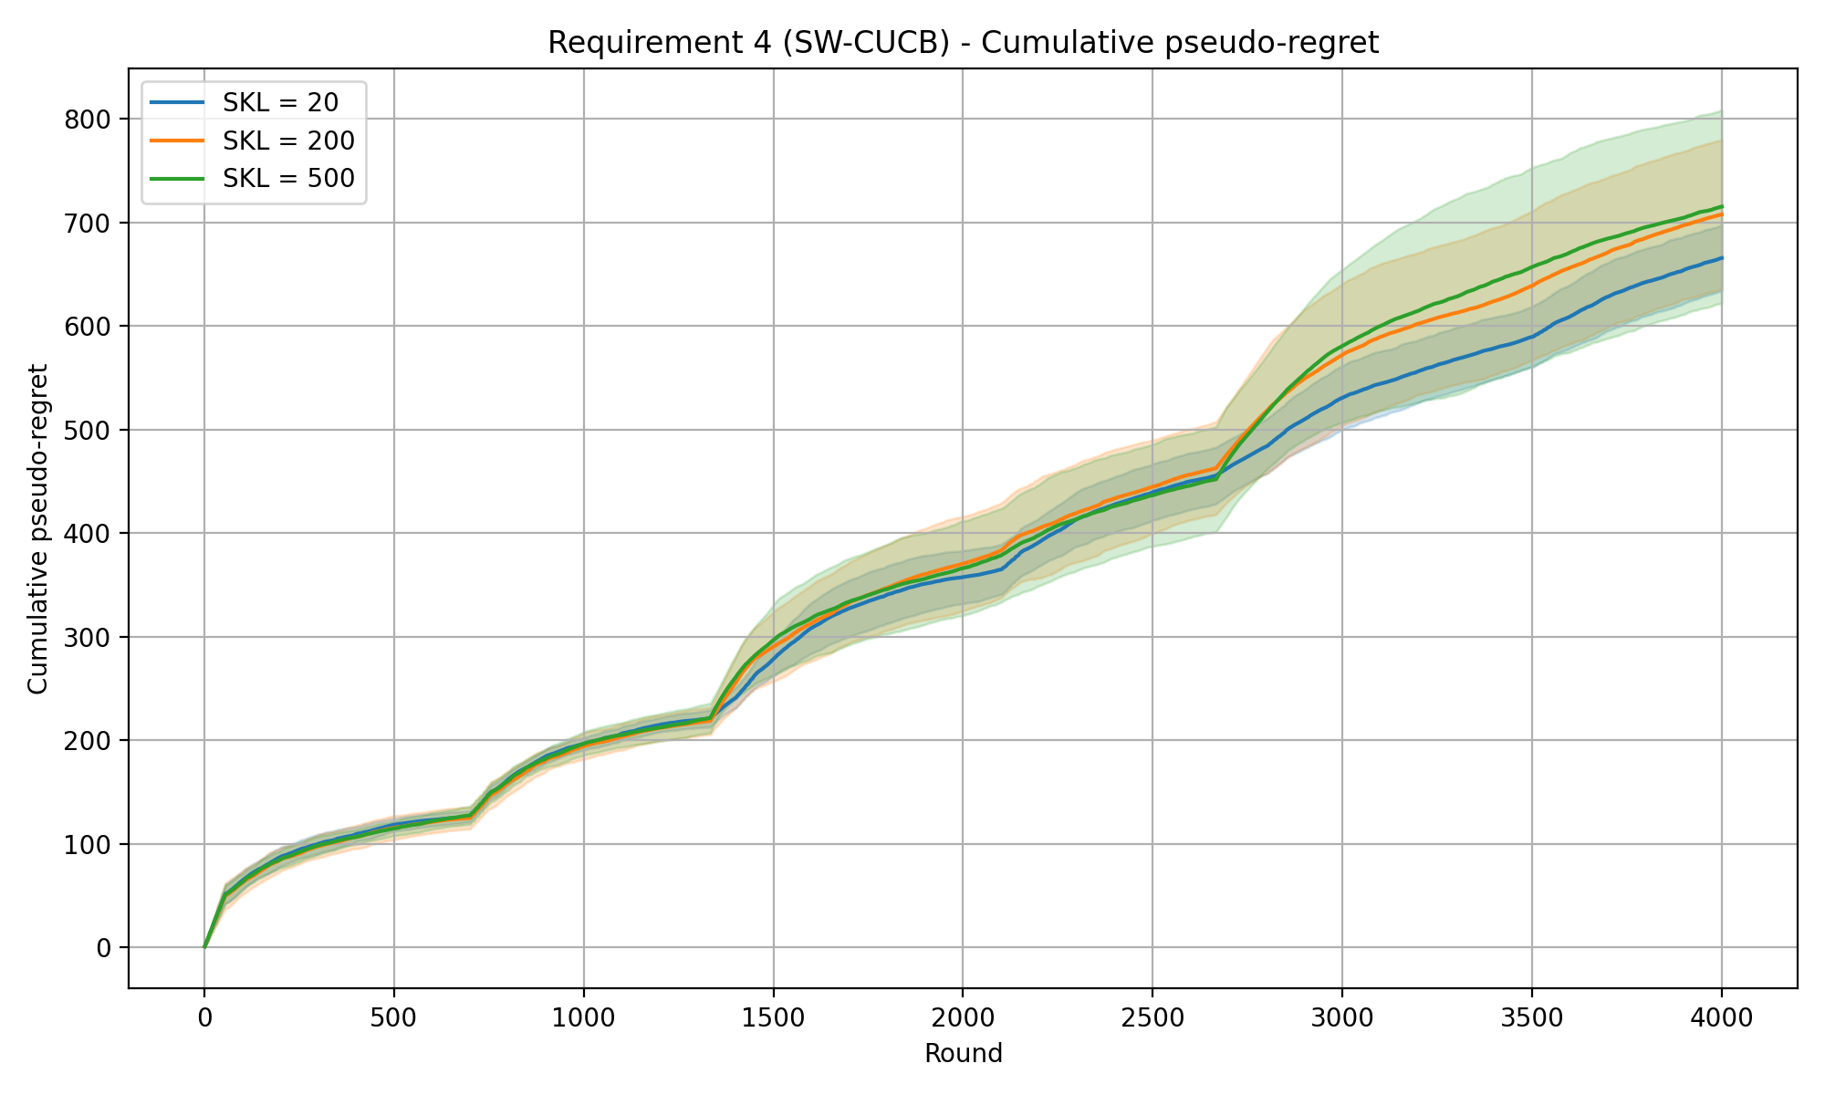
REQUIREMENT 4 · SLIDING-WINDOW CUCB · EXPERIMENTS
SW-CUCB — cumulative pseudo-regret
Experiment setup
Time horizon T
Intervals
Budget B
Per-round budget ρ = B / T
Exploration coeff. c
Window size W
4000
3
8000
2.0
0.1
700
SKL levels (curves) 20 / 200 / 500
Shaded bands: mean ± std across 20 repeated runs.
SW-CUCB · cumReg_3int_700win_0.1exp

Slide 51
REQUIREMENT 4 · SLIGHTLY NON-STATIONARY ENVIRONMENT
Combinatorial-UCB with Change Detector
The idea. Keep the Combinatorial-UCB machinery, but attach a CUSUM change detector to every (campaign, bid) arm. While a regime is stable it behaves like standard CUCB; when a detector fires, statistics are reset — either only that arm or every arm (see reset scope) — so the learner re-learns under the new distribution.
How it works
CUSUM parameters
M — warm-up samples → reference win-rate
ε — slack: ignore small deviations
h — detection threshold
ever_pulled — mask for the forced initial exploration
α — forced exploration parameter
▪ Win-indicator signal: each arm monitors the Bernoulli win indicator, not the raw reward: reward = win·(value − bid) shrinks as the bid grows, so a single threshold would be unfair across arms. The win indicator stays in [0, 1] for every arm.
▪ CUSUM detector: after M warm-up samples fix a reference win-rate; the statistics g⁺ / g⁻ accumulate deviations beyond a slack ε, and an alarm fires when either exceeds the threshold h.
▪ Forced exploration (α): with probability α the agent plays a random budget-feasible super-arm, so arms outside the current optimum keep feeding their detectors.
▪ Low exploration coefficient c: the same reasoning as in the sliding-window approach applies here as well.
▪ UCB estimates: both the exploitation term (the mean estimate) and the exploration term use only the samples gathered since the last reset; the exploration numerator is the total valid samples across arms, and each arm's count restarts on a detection.
Reset scope — two modes
per-arm — wipe only the firing arm.
global — restart every arm; fits synchronized regime shifts.
ola/algorithms/cd_cucb.py

Slide 52
REQUIREMENT 4 · SLIGHTLY NON-STATIONARY ENVIRONMENT
Combinatorial-UCB with Change Detector
Parameters estimation
α –forced exploration parameter
alpha = sqrt(Y_T * log(T / Y_T) / T)
M – Warm-up samples
M = int(log(T / Y_T))
h — Detection threshold
h = 2 * log(T / Y_T)
ola/algorithms/cd_cucb.py

Slide 53
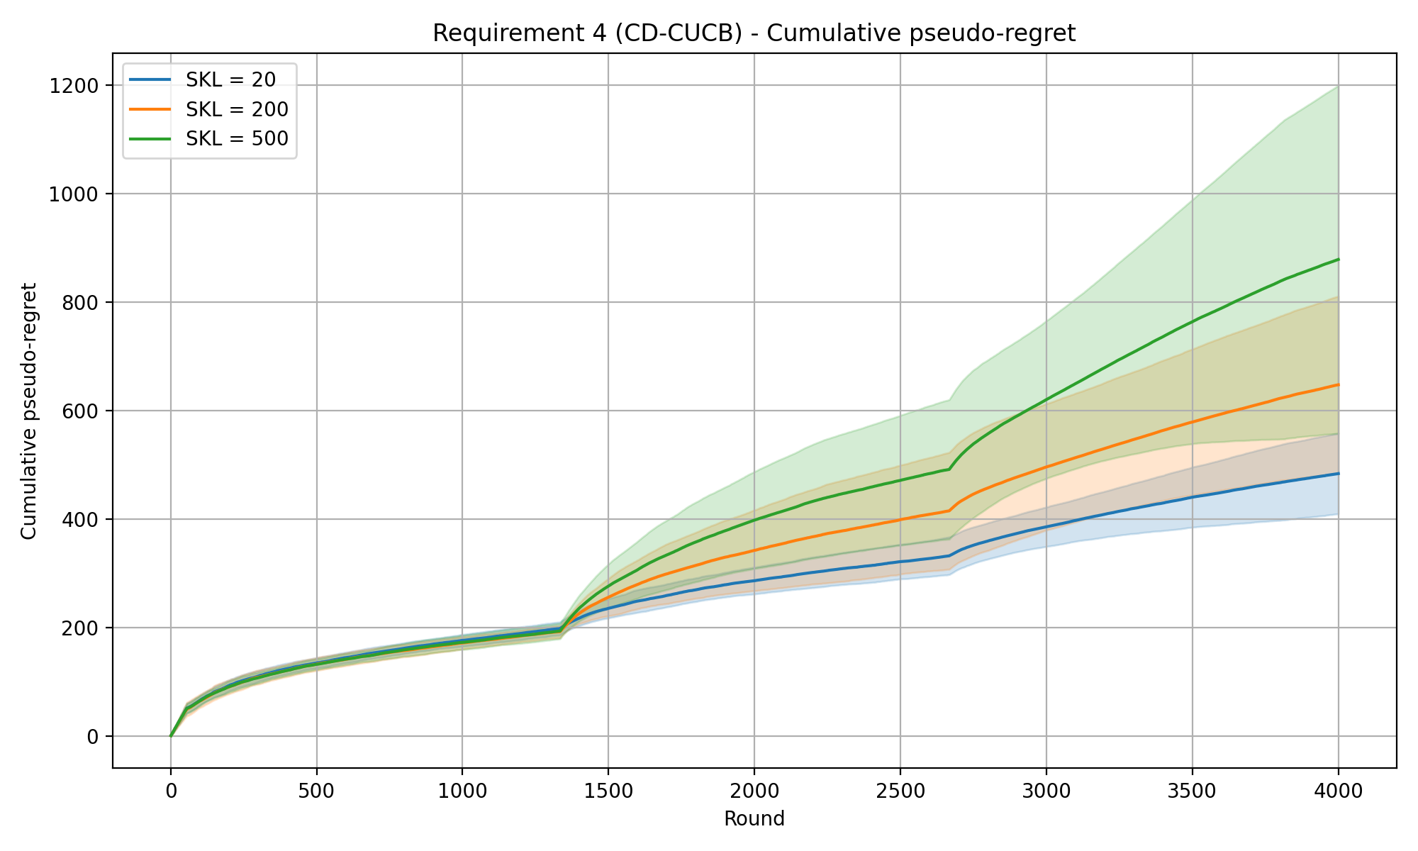
REQUIREMENT 4 · CHANGE-DETECTOR CUCB · EXPERIMENTS · PER-ARM RESET
CD-CUCB (CUSUM) — cumulative pseudo-regret
Experiment setup
Time horizon T
Intervals
Budget B
Per-round budget ρ = B / T
Exploration coeff. c
CUSUM slack ε
Warm-up samples M
Detection threshold h
Forced-explore prob. α
4000
3
8000
2.0
0.1
0.1
7
15.2
0.0616
SKL levels (curves) 20 / 200 / 500
Mean detection delay (rounds)
SKL 20
SKL 200
SKL 500
94.2 ±144
55.9 ±90
41.5 ±66
Shaded bands: mean ± std across 20 repeated runs.
CD-CUCB (CUSUM) · cumReg_3int_0.1eps_0.1exp

Slide 54
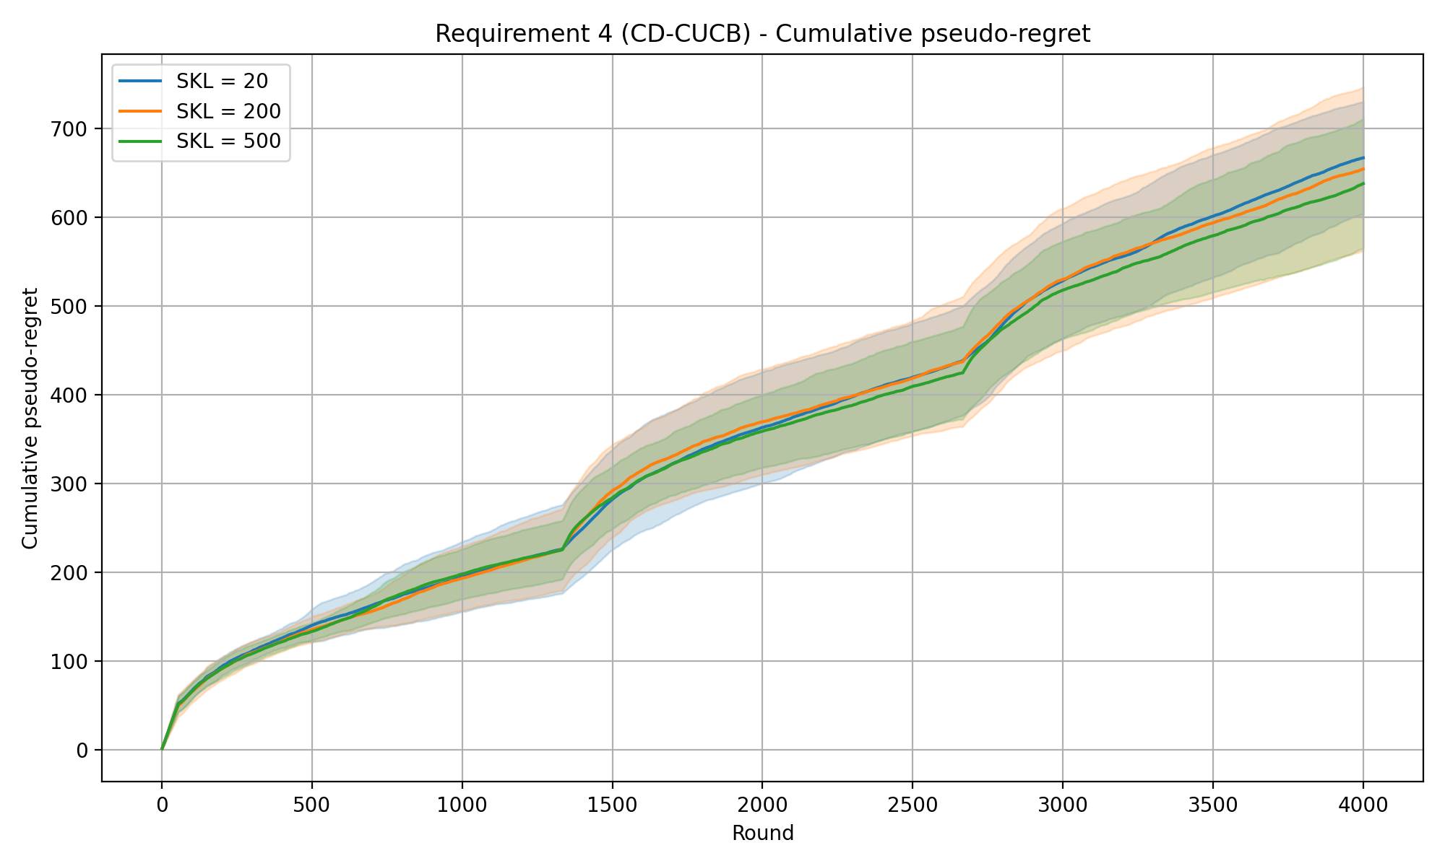
REQUIREMENT 4 · CHANGE-DETECTOR CUCB · EXPERIMENTS · GLOBAL RESET
CD-CUCB (CUSUM) — cumulative pseudo-regret
Experiment setup
Time horizon T
Intervals
Budget B
Per-round budget ρ = B / T
Exploration coeff. c
CUSUM slack ε
Warm-up samples M
Detection threshold h
Forced-explore prob. α
4000
3
8000
2.0
0.1
0.1
7
15.2
0.0616
SKL levels (curves) 20 / 200 / 500
Mean detection delay (rounds)
SKL 20
SKL 200
SKL 500
115.1 ±158.0
73.8 ±86.2
58.5 ±116.3
Shaded bands: mean ± std across 20 repeated runs.
CD-CUCB (CUSUM) · cumReg_3int_0.1eps_0.1exp_GlobReset

Slide 55
REQUIREMENT 4 · CHANGE-DETECTOR CUCB
Change Detection with Normal Discrepancy
The idea. A single joint detector watches the whole vector of competing bids over a sliding window: when the window's first and second halves look like different distributions, detect a change and restart the learner. Normal Discrepancy also exploits the multivariate structure of the Gaussians used in the experiments to detect change points more effectively.
How it works
Normal Discrepancy
▪ Joint detector on m(t): a single detector watches the full N-dimensional competing-bid vector over a sliding window of the last nd_window_size rounds — not one detector per arm.
▪ Normal Discrepancy: split the window at its midpoint and compare the full-window covariance with its two halves. ND ≈ 0 when both halves share a distribution and grows when a change sits inside the window.
▪ Full feedback: the detector, as well as the UCB algorithm, exploit the information of the full-feedback approach.
▪ Global reset: being a single joint detector, one alarm restarts every arm and clears the window — the reset is always global.
▪ No need for forced exploration: since the UCB estimator uses the full-feedback information, the forced exploration parameter is set to 0. Also, the exploration term of the UCB formula is ignored. The mean estimates are the only considered term.
Σ: full-window covariance; Σ_L, Σ_R: its two half-windows. ND ≈ 0 with no change, spikes on a shift.
ND parameters
nd_window_size — window length
nd_threshold — alarm level
ola/algorithms/cd_cucb.py · detector_type = nd_full_feedback

Slide 56
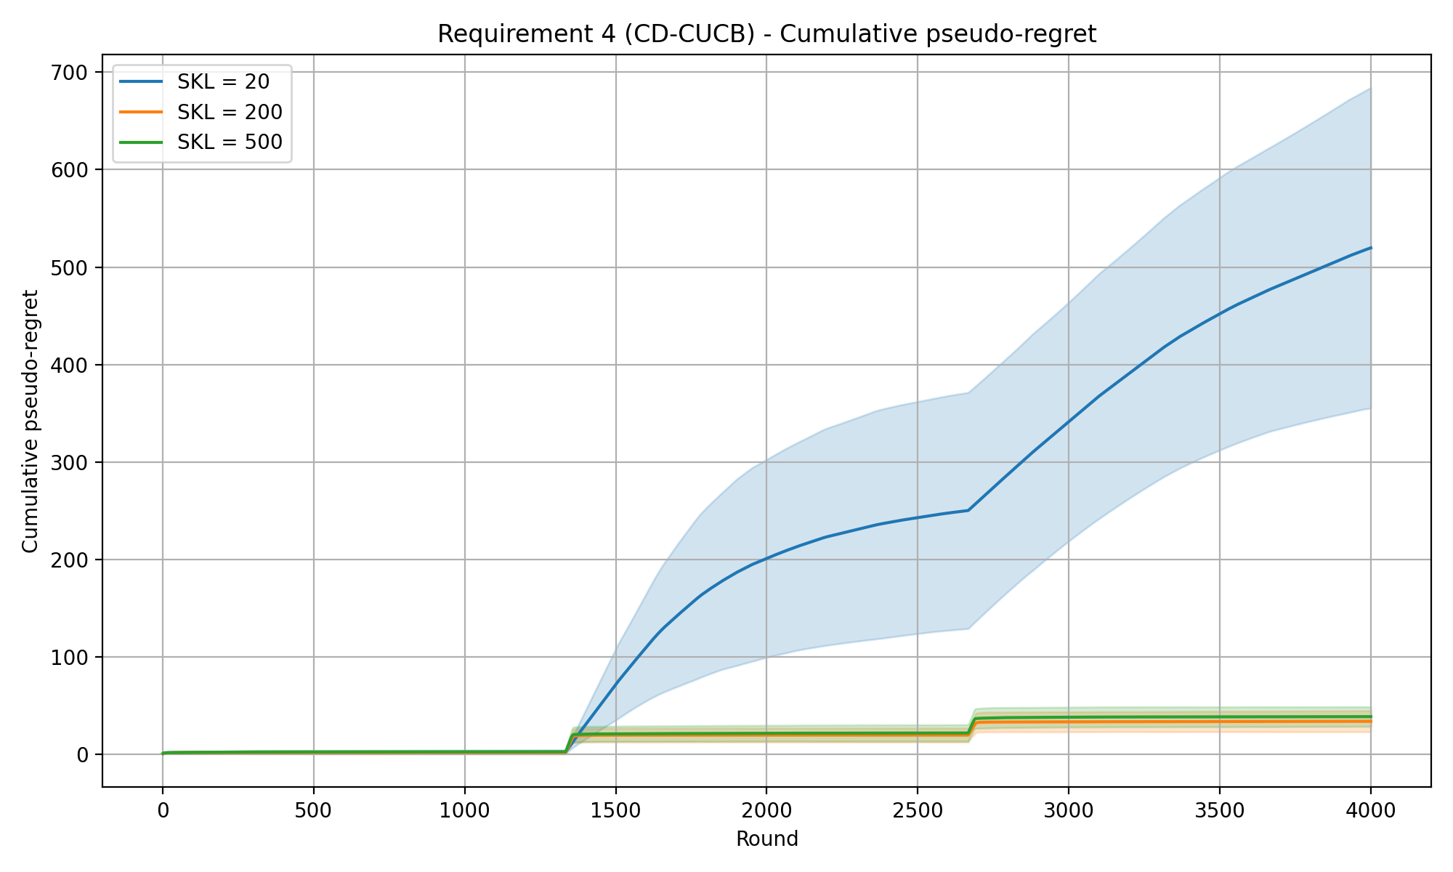
REQUIREMENT 4 · CHANGE-DETECTOR CUCB · EXPERIMENTS
CD-CUCB (ND) — cumulative pseudo-regret
Experiment setup
Time horizon T
Intervals
Budget B
Per-round budget ρ = B / T
Exploration coeff. c
ND threshold
ND window size
4000
3
8000
2.0
0.1
3
50
SKL levels (curves) 20 / 200 / 500
Mean detection delay (rounds)
SKL 20
SKL 200
SKL 500
n/a
22.2 ±2.0
18.9 ±3.2
Shaded bands: mean ± std across 20 repeated runs.
SKL 20: no change detected.
CD-CUCB (ND) · ND_ec=0.1 (threshold = 3)

Slide 57
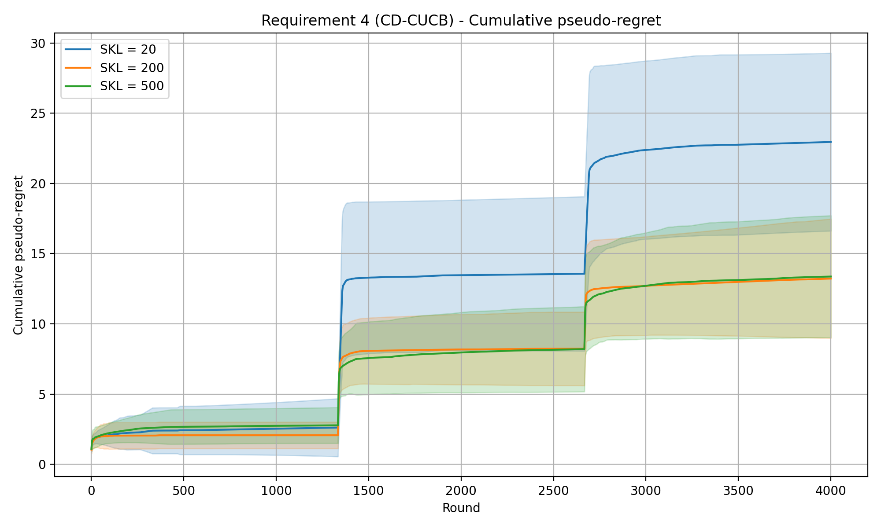
REQUIREMENT 4 · CHANGE-DETECTOR CUCB · EXPERIMENTS
CD-CUCB (ND) — cumulative pseudo-regret
Experiment setup
Time horizon T
Intervals
Budget B
Per-round budget ρ = B / T
Exploration coeff. c
ND threshold
ND window size
4000
3
8000
2.0
0.1
1.5
50
SKL levels (curves) 20 / 200 / 500
Mean detection delay (rounds)
SKL 20
SKL 200
SKL 500
19.9 ±2.8
4.6 ±2.0
1.9 ±1.3
Shaded bands: mean ± std across 20 repeated runs.
CD-CUCB (ND) · ND_ec=0.1_threshold=1.5

Slide 58
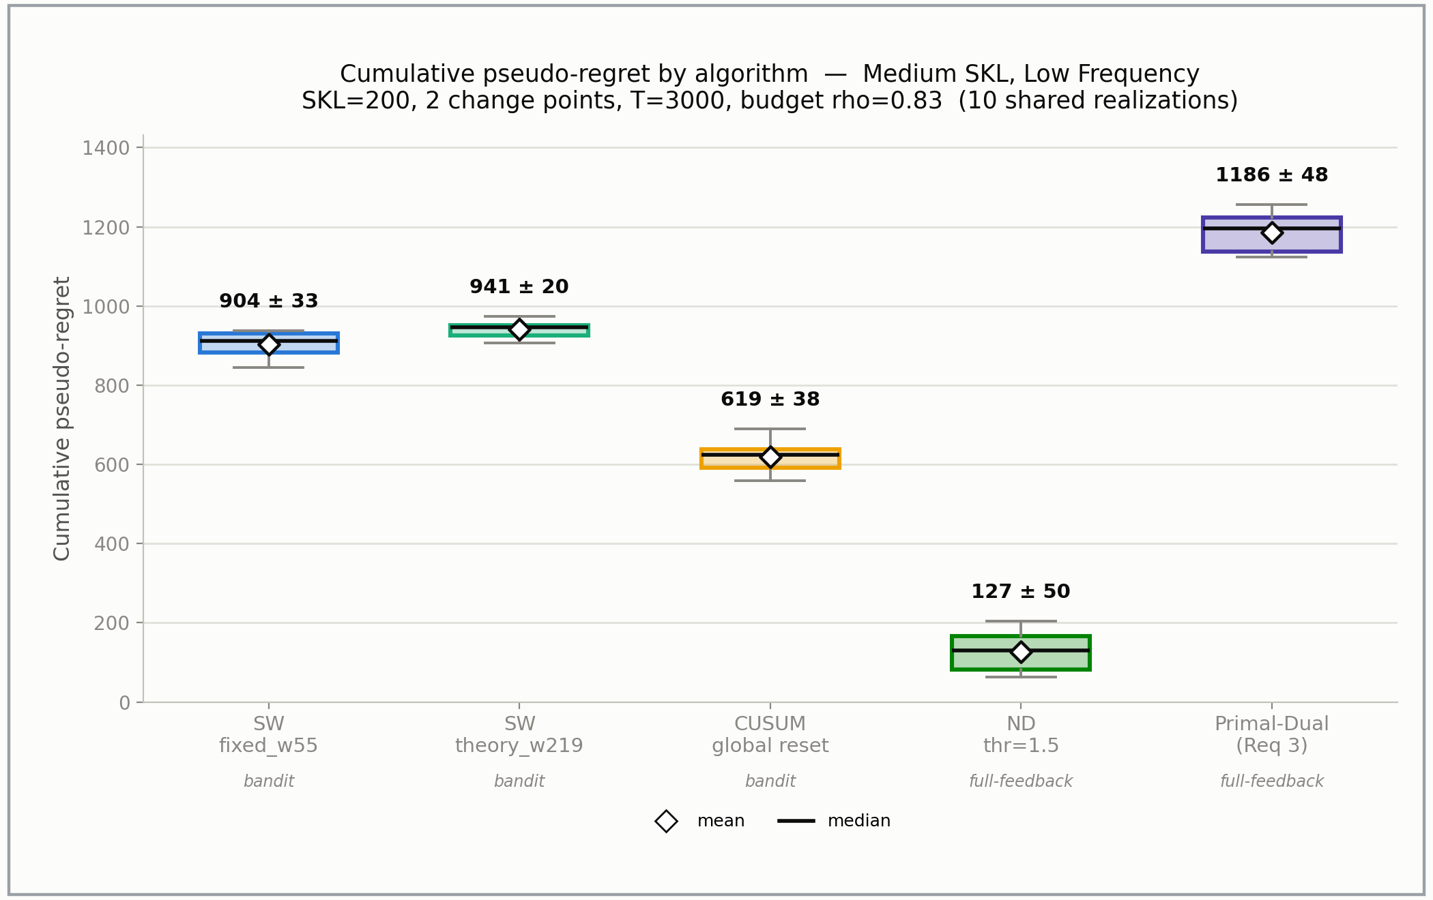
REQUIREMENT 4 ·COMPARISON
LOW FREQUENCY MEDIUM SKL — CUMULATIVE REGRET
Comparison

Slide 59
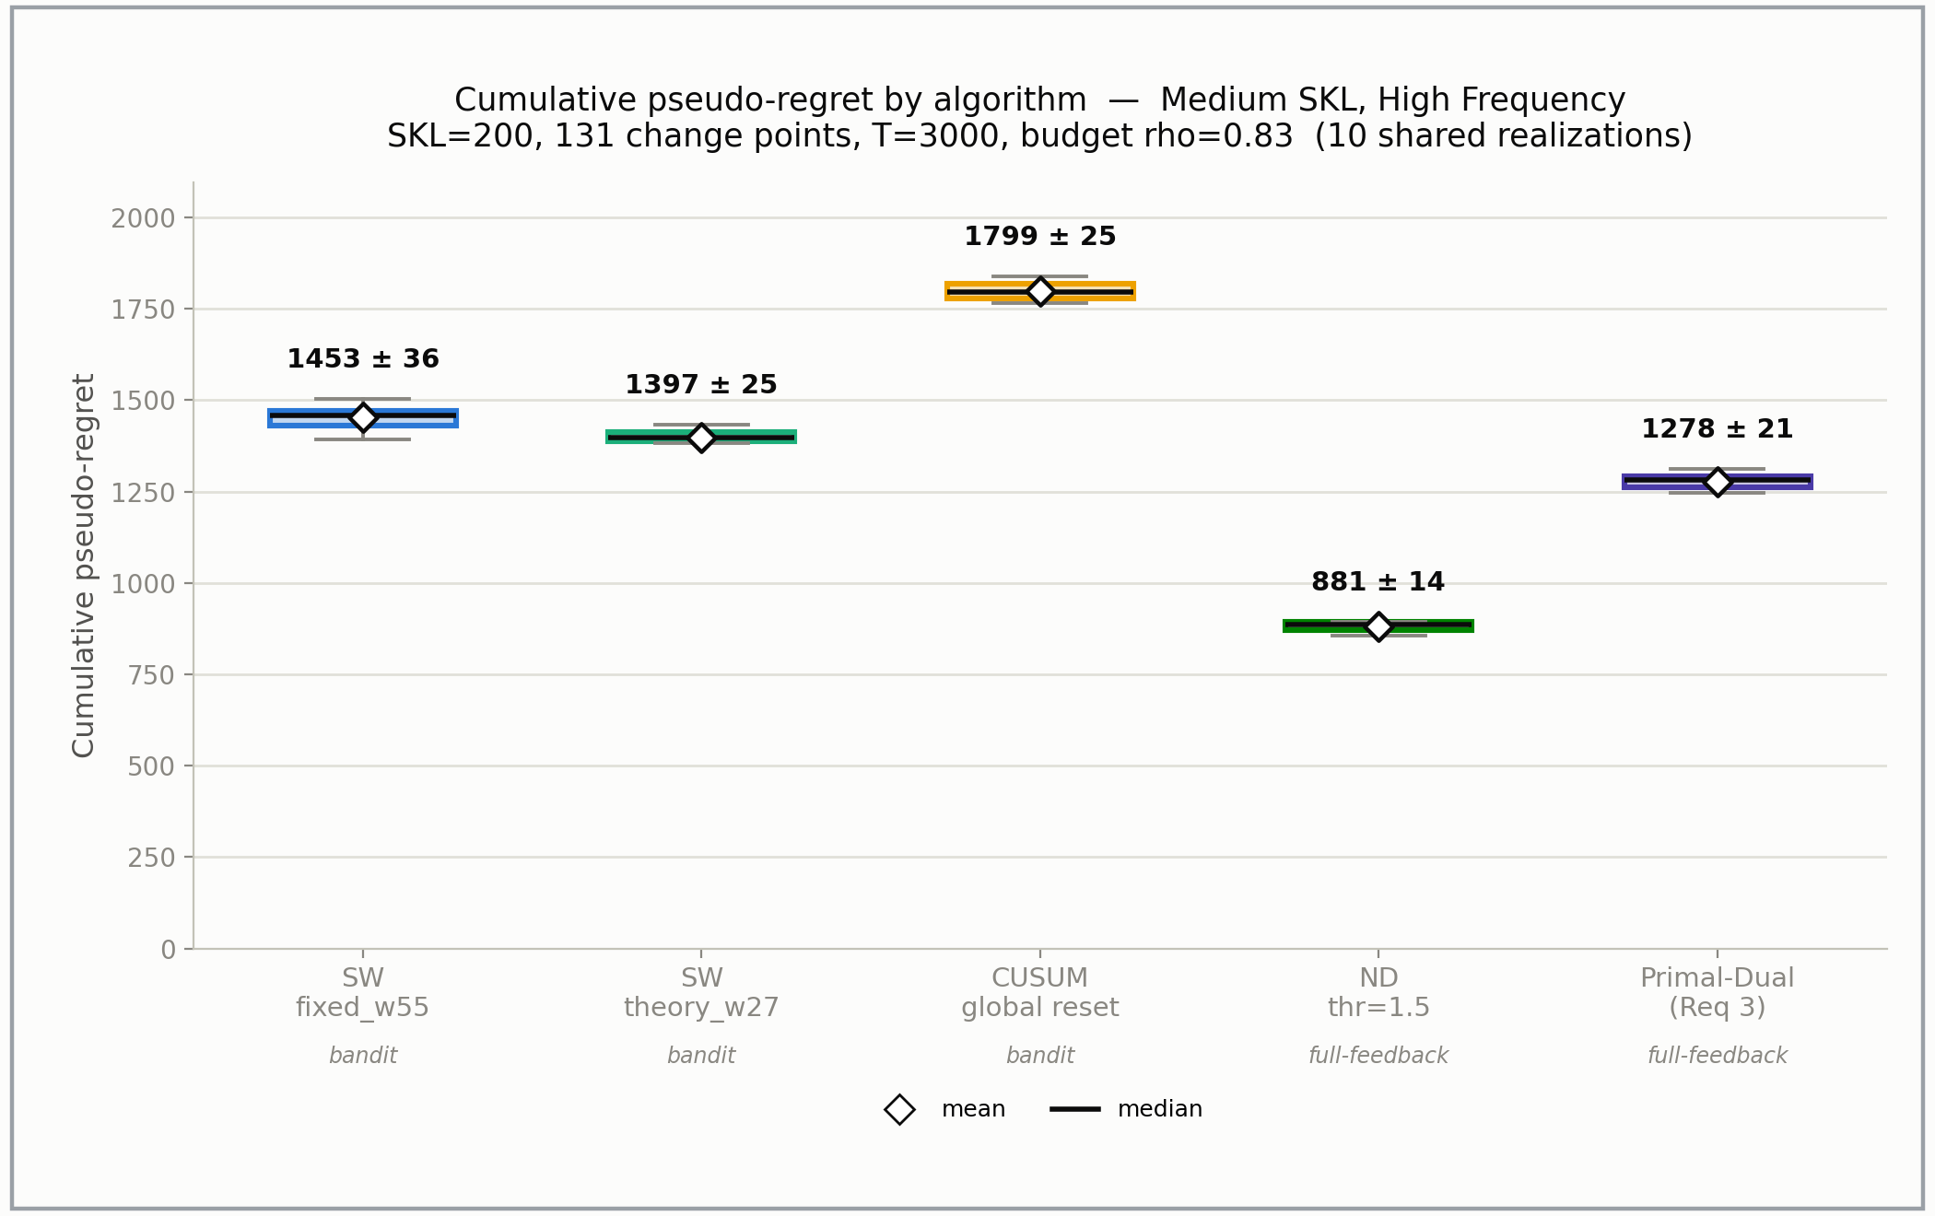
REQUIREMENT 4 ·COMPARISON
HIGH FREQUENCY MEDIUM SKL — CUMULATIVE REGRET
Comparison

Slide 60
Future work…
Analyze behaviour with non-abrupt changes
Recurring state of the market

Slide 61
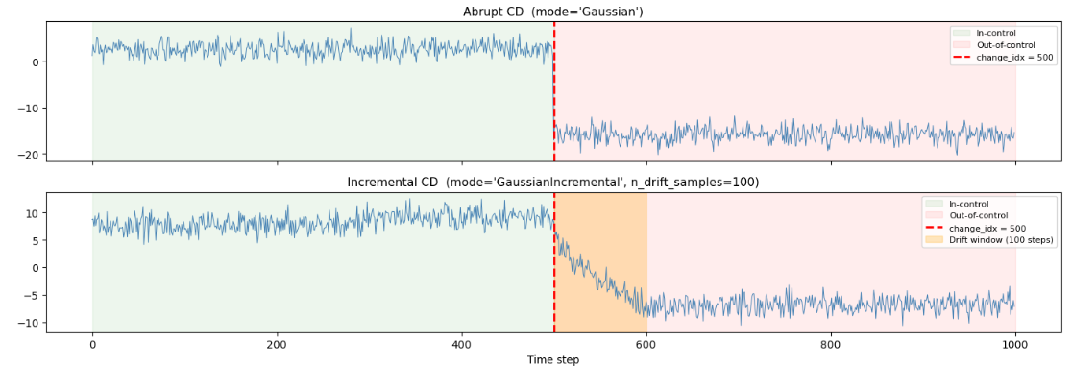
Incremental CD
Tested to make sure that:
Transition is monotone → if μ1≤ μT then μ1≤μ2≤… μT
ΔSKL is the same amongst every sample

Slide 62
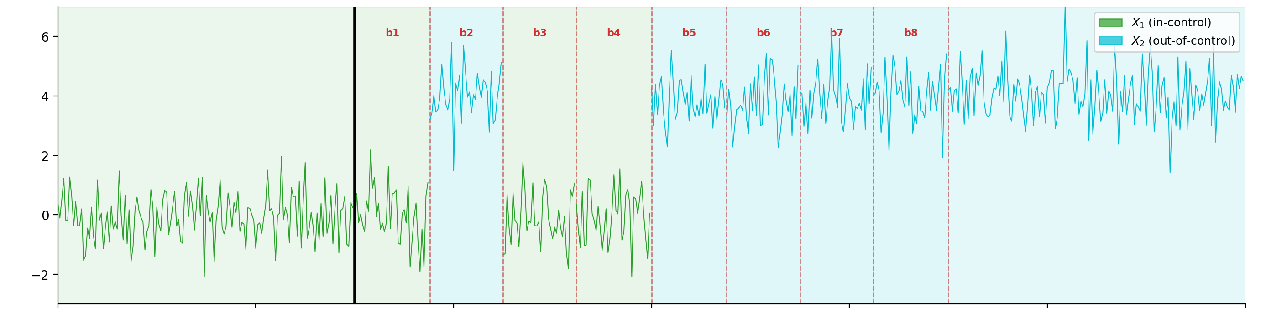
Gradual CD
3 distinct phase:
In control phase: where just φ0 is present
Transition phase: where φ0 and φ1 alternates (for each block bi a distribution is sorted)
Out of control phase: where just φ1 is present

Slide 63
Recurring state of the market
In normal case scenario we know that seasonality impose recurring states. Our environment of gaussian constellation adapts very well that case. Useful tests so could be to implement something like Learn++.NSE to have multiple models and updates their weights of importance when the environment that would require that eventually comes up again.
References
Elwell, R., & Polikar, R. (2011). Incremental Learning of Concept Drift in Nonstationary Environments. IEEE Transactions on Neural Networks, 22(10), 1517–1531. https://doi.org/10.1109/tnn.2011.2160459 Cited by: 1230

Slide 64
Any question?

